Slide 1

Introduction to Sex Trafficking in Indian Country
Sex Trafficking in Indian Country: Advocacy Curriculum | Unit 1
Prepared by the Tribal Law and Policy Institute
This resource was supported by grants awarded by the Office on Violence Against Women, U.S. Department of Justice. The opinions, findings, conclusions, and recommendations expressed in this publication/program/exhibition are those of the author(s) and do not necessarily reflect the views of the Department of Justice, Office on Violence Against Women.
Sex Trafficking in Indian Country: Advocacy Curriculum | Unit 1 | Tribal Law and Policy Institute | 1

Slide 2
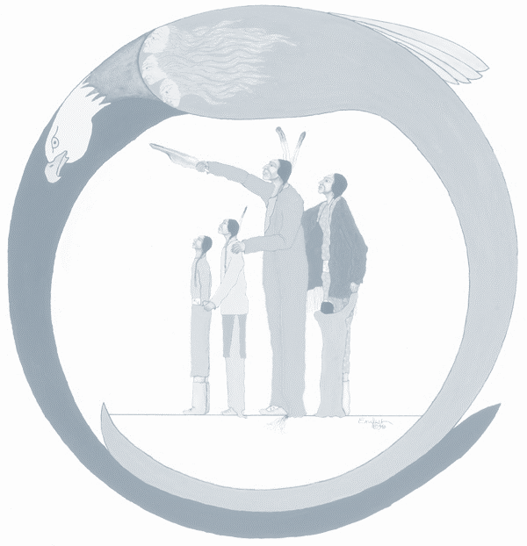
Training Agenda
Welcome, Invocation, Introduction, and Housekeeping
Overview of Unit and Learning Objectives
“Training Expectations”—Large Group Exercise
What Is Sex Trafficking?
Advocate’s Working Definition
Common Misconceptions
“Anything of Value”—Small Group Exercise
“No Force, Fraud, or Coercion Required”—Large Group Exercise
Where Does Sex Trafficking Occur?
Why Does Sex Trafficking Occur?
Question and Answer

Slide 3
Learning Objectives
Objectives –As a result of participating in this workshop, you will be better able to:
  Discuss sex trafficking generally;
  Discuss why sex trafficking occurs;
  Identify where sex trafficking can occur;
  Identify some sex trafficking risk factors; and
  Understand the importance of identifying sex trafficking myths and misconceptions.

Slide 4
Training Expectations
Large Group Exercise

Slide 5
Large Group Exercise
What are one to two expectations that you have for this training ?

Slide 6
Legal Definition of Sex Trafficking
Federal Definition (18 U.S.C. §1591(a))
(a)Whoever knowingly—
(1) in or affecting interstate or foreign commerce, or within the special maritime and territorial jurisdiction of the United States, recruits, entices, harbors, transports, provides, obtains, advertises, maintains, patronizes, or solicits by any means a person; or
(2) benefits, financially or by receiving anything of value, from participation in a venture which has engaged in an act described in violation of paragraph (1),
knowing, or, except where the act constituting the violation of paragraph (1) is advertising, in reckless disregard of the fact, that means of force, threats of force, fraud, coercion described in subsection (e)(2), or any combination of such means will be used to cause the person to engage in a commercial sex act, or that the person has not attained the age of 18 years and will be caused to engage in a commercial sex act, shall be punished as provided in subsection (b).

Slide 7
Legal Definition of Sex Trafficking
Please Note: Force, fraud, and coercion are legal terms that will vary depending on the jurisdiction.
18 U.S.C. §1591(e) provides definitions for coercion and other terms used in 18 U.S.C. §1591(a)
  (e)In this section: …
  (2)The term “coercion” means—
  (A)threats of serious harm to or physical restraint against any person;
  (B)any scheme, plan, or pattern intended to cause a person to believe that failure to perform an act would result in serious harm to or physical restraint against any person; or
  (C)the abuse or threatened abuse of law or the legal process.

Slide 8
Advocate’s Working Definition of
Sex Trafficking
Sex trafficking is the sexual exploitation of another person for personal/commercial gain.
This crime usually includes the trafficker exercising power and control over the victim.
Victims may not be free to come and go as they choose.
Remember “force, fraud, or coercion” needs to be proven if the victim is over 18 years of age.

Slide 9
Common Misconceptions
Sex trafficking must involve kidnapping, confinement, or physical force.
Sex trafficking must involve travel across state or international boundaries.
Traffickers are always strangers to the victim.
Sex trafficking victims are always female.
Getting paid any amount means an individual cannot also be a victim.
Victims are eager to receive help, self-identify, and discuss their victimization.
Domestic violence is always different from sex trafficking.
Sex trafficking always involves the exchange of money.

Slide 10
Myths and Misconceptions
Notes:
This slide is intentionally left blank to allow the facilitator to customize to their community.

Slide 11
Myths and Misconceptions
Notes:
This slide is intentionally left blank to allow the facilitator to customize to their community.

Slide 12
Small Group Exercise
  Anything of Value

Slide 13
Small Group Exercise
  What items may be of value to you?
  Identify an object other than money with your small group.

Slide 14
Large Group Exercise
No Force, Fraud, or Coercion Required

Slide 15
Large Group Exercise
Review and reflect on the federal definition of sex trafficking provided in this resource. Why do you think this law does not require a showing of force, fraud, or coercion if a person is under the age of eighteen years?
Take a minute to think, then list possible answers in your workbook.

Slide 16
Where Does Sex Trafficking Occur?
  Private homes
  Hotels
  Casinos
  Truck stops
  Bus terminals
  Pow-wow grounds
  Malls
  Detention facilities
  Shelters
  Bars

Slide 17
Where Does Sex Trafficking Occur?
Do you know if sex trafficking is occurring in your community?
Do you know where sex trafficking occurs in your tribal community?
Where do you think sex trafficking may occur?

Slide 18
Why Does Sex Trafficking Occur?
  Limited research available;
  Social risk factors may make it more likely in tribal communities;
  Native Nations stripped of jurisdictional authority to combat the problem;
  Substance use and abuse can contribute;
  Housing and family instability; and
  Contemporary problem, but can be linked to colonization.

Slide 19
Why Does Sex Trafficking Occur?
  Precontact Native peoples had varied traditions and some considered violence against women taboo;
  Colonization disrupted Native lifeways and imposed a new social, political, and religious worldview;
  Postcontact, Native women’s bodies were commoditized, exploited; and
  Native women and girls viewed as hypersexual and sexually objectified.

Slide 20
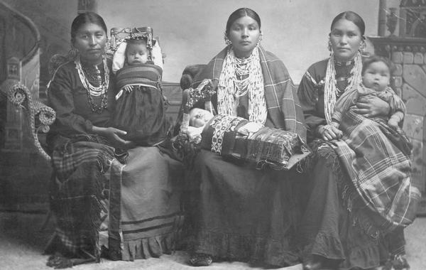
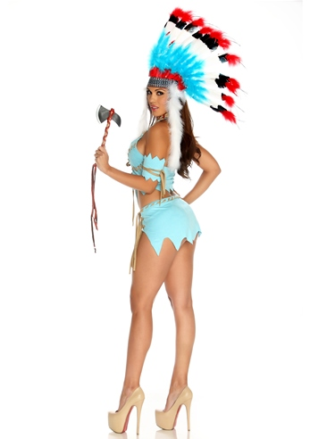

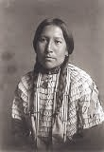
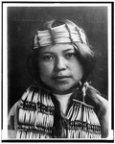
Colonization and Sex Trafficking
Colonization

Slide 21
Systemic Change to a Systemic Problem
  Contemporary sex trafficking is a symptom of colonization.
  Advocates and tribal communities must address societal norms and attitudes.
  Identify and dismantle systems that support traffickers.
  Look to traditional community values that can be used to support anti-trafficking efforts.

Slide 22
Additional Resources

Slide 23
Additional Resources
Notes:
This slide is intentionally left blank to allow the facilitator to customize to their community.

Slide 24
Additional Resources
Notes:
This slide is intentionally left blank to allow the facilitator to customize to their community.

Slide 25

Questions?

Slide 26
Identifying & Screening for Sex Trafficking
Sex Trafficking in Indian Country: Advocacy Curriculum | Unit 2
Prepared by the Tribal Law and Policy Institute
This resource was supported by grants awarded by the Office on Violence Against Women, U.S. Department of Justice. The opinions, findings, conclusions, and recommendations expressed in this publication/program/exhibition are those of the author(s) and do not necessarily reflect the views of the Department of Justice, Office on Violence Against Women.
Sex Trafficking in Indian Country: Advocacy Curriculum | Unit 2 | Tribal Law and Policy Institute | 26

Slide 27
Training Agenda
Introductions, Agenda, Overview of Unit, and Learning Objectives
“Identifying Sex Trafficking”—Video and Large Group Discussion
Who Are Sex Traffickers?
What Do Traffickers Look For?
Risk Factors
Types of Sex Trafficking
Tactics Used by Traffickers
Correlations to Domestic Violence
Sex Trafficking Red Flags
“Fact Patterns”—Small Group Exercise
Interviewing a Victim
Initial Safety Assessment
Screening Tools
“Developing a Culturally Appropriate Screening Tool”—Small Group Exercise
Question and Answer

Slide 28
Learning Objectives
  As a result of participating in this workshop you will be better able to:
  Identify “types” of trafficking;
  Identify methods used by traffickers against victims;
  Identify red flags that may indicate a person as a victim of sex trafficking; and
  Identify actions that an advocate can take to make the victim feel safer during an interview.

Slide 29
Large Group Activity
Video: Native American Trafficking
available at
https://www.youtube.com/watch?v=VjeDTTw8tco

Slide 30
Discussion Questions for Video
  What is your initial reaction?
  What were some key words/red flags?
  Name some contributing factors that were highlighted.
  Name some of the tactics traffickers used.
  Where are some locations that sex trafficking may be occurring in your community?
  Were the types of traffickers in the video different than you expected them to be?
  Was there anything you did not like about the video or thought the video got wrong?

Slide 31
Who Are Sex Traffickers?
  Family members;
  Gangs;
  Strangers;
  New “friends”;
  Community members;
  Business owners;
  Intimate partners; and
  People in positions of actual or perceived authority.

Slide 32
Who Are Sex Traffickers?
  Who do you think traffickers are?
  What made you think the person was a trafficker?
  What kinds of traffickers have you encountered in your work as an advocate?
  What do traffickers look like?

Slide 33
What Do Traffickers Look For?
  People who can yield a greater profit;
  People who can “pass” as many races/ethnicities;
  People lacking a strong support system;
  Adolescents with little supervision;
  Runaway youth or Homeless youth;
  People from impoverished neighborhoods;
  People who are less assertive or mild tempered;
  People who are vulnerable to blackmail;
  People who have a strong interest in protecting others from the trafficker;
  People with alcohol or substance abuse issues; and
  People previously raped or molested.

Slide 34
What Do Traffickers Look For?
  Which of the factors might make Native people more attractive to a trafficker?

Slide 35
Risk Factors Related to
Sex Trafficking Victimization
  Age (minors may be more susceptible);
  Poverty and/or unemployment;
  Homelessness;
  Substance abuse/dependency;
  LGBTQ/Two Spirit;
  Lack of support or support systems;
  Developmentally challenged, mental health challenges;
  Lack of educational opportunities;
  History of abuse and sexual abuse;
  Child welfare system and/or foster care involvement;
  Unsupervised youth; and
  Family history of violence and abuse.
  Others?

Slide 36
Risk Factors Related to
Sex Trafficking Victimization
  What risk factors are present in your tribal community?

Slide 37
“Types” of Sex Trafficking
  Family trafficking
  Organized criminal trafficking
  Gang trafficking
  Pimp trafficking
  “Officials” trafficking (trafficking as an abuse of power or authority)

Slide 38
“Types” of Sex Trafficking
  Think back to the risk factors you identified in your community.
  Is there a certain type (or types) of sex trafficking that can exploit these risk factors?

Slide 39
Trafficker Tactics
  Fraud (an “exciting business proposition”);
  False promises;
  Drugs and alcohol;
  Domestic violence tactics;
  Threats/blackmail;
  Gifts, special treatment, luxury items;

Slide 40
Trafficker Tactics
  Inflicting sexual, emotional, or mental abuse;
  Inducing or enabling substance addiction;
  Threatening to harm victim or victim’s family;
  Withholding money;
  Violent physical assaults;
  Rape;
  Torture;
  Imprisonment;
  Debt bondage;
  Psychological abuse/brainwashing;
  Coercion;
  False affection/love;
  Isolation; and
  Fear of arrest or prosecution.

Slide 41
Correlations to Domestic Violence
  Physical/psychological methods of power and control;
  Victim has an overwhelming sense of fear;
  Beatings or physical restraint not necessary;
  Dependency;
  Dictates or restricts movement/outside contact; and
  Isolation.

Slide 42
Correlations to Domestic Violence
  Threats and physical abuse may also enforce silence when the victim comes into contact with the justice system.
  Emotional harm can be just as damaging to a victim as physical violence. For example, threatening to “out” an LBGTQ/2 individual to their community or family may mean the loss of social and economic support.

Slide 43
Correlations to Domestic Violence
  For those encountering victims of trafficking through the justice system, remember that the dynamics of control and coercion may affect their ability to use legal system resources effectively.
  Sex trafficking and domestic violence can include isolation, economic abuse, and gaslighting so the victim feels responsible for the violence.

Slide 44
Correlations to Domestic Violence
  As you think about correlations to domestic violence, think about the trafficker’s motives.
  What are their motives?
  Why are they doing this?

Slide 45
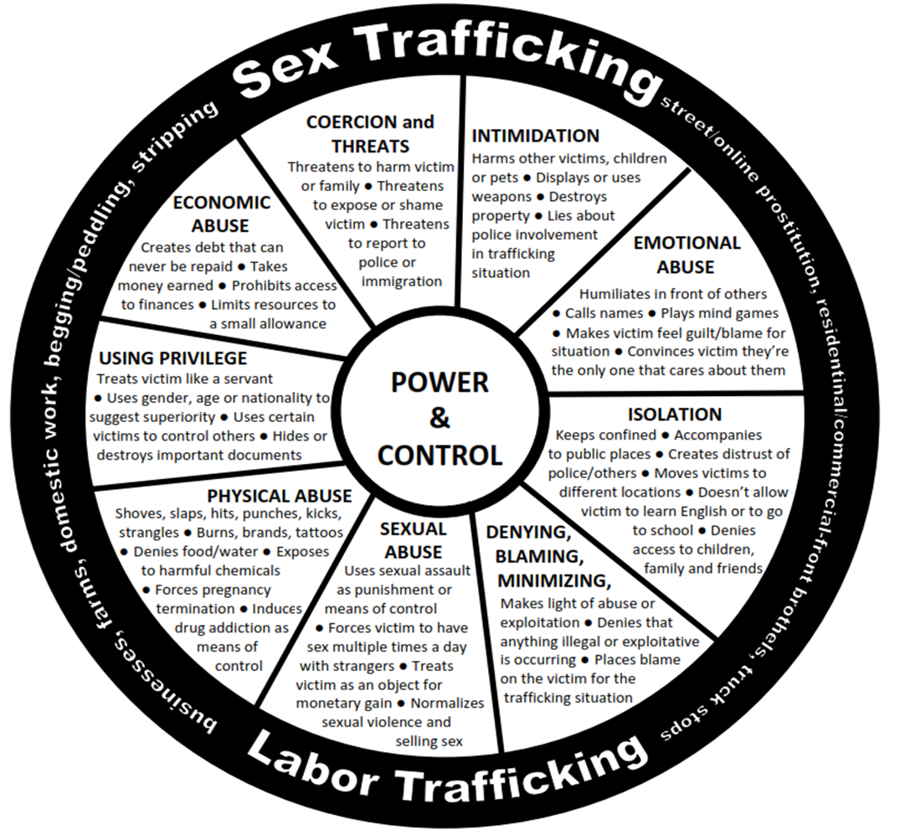
This wheel was adapted from the Domestic Abuse Intervention Project’s Duluth Model Power and Control Wheel, available at www.theduluthmodel.org.
Polaris Project | P.O. Box 53315, Washington, DC 20009 | Tel: 202.745.1001 | Info@PolarisProject.org |
https://humantraffickinghotline.org/resources/human-trafficking-power-and-control-wheel
© Copyright Polaris Project, 2010. All Rights Reserved.

Slide 46
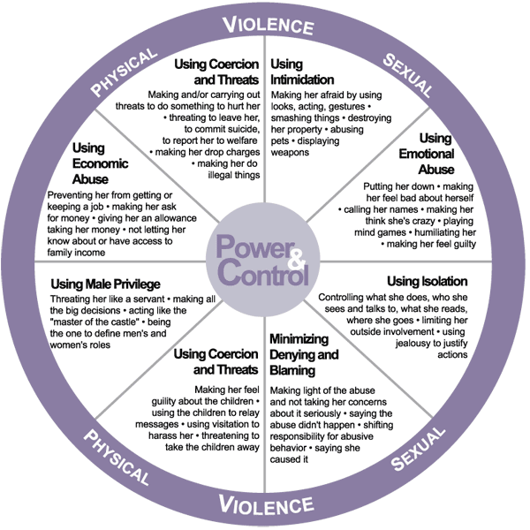
DOMESTIC ABUSE INTERVENTION PROGRAMS
202 East Superior Street
Duluth, Minnesota 55802
218-722-2781
Available at www.theduluthmodel.org

Slide 47
Sex Trafficking Red Flags
  Fearful, extremely intimidated while speaking to others;
  Inability or unwillingness to make eye contact;
  Physically malnourished;
  Signs of abuse, torture, or injury;
  Tattoos, burns, brands to indicate ownership;
  Signs of substance abuse/addiction⎯tracks, lethargic, incoherent;
  Clothing inappropriate for climate;
  Personal hygiene unkempt, not being allowed to shower or bathe;

Slide 48
Sex Trafficking Red Flags
  Receives a call or text that makes them want to leave immediately;
  Signs of external monitoring, lack of freedom;
  Scripted responses;
  Financial dependency;
  Communicates they are not in danger when similarly situated individuals might feel afraid; and
  Incomplete or contradictory victim disclosures.

Slide 49
Red Flags in Adolescents
Cut ties with usual friends;
Involved in a subordinate relationship with an older “friend”;
School performance/attendance has dramatically diminished;
Picked up/dropped off by a much older, unrelated person they described as their boyfriend/girlfriend or “friend”;
Refers to sexual situations that are beyond their developmental age;
Accompanied by someone who monitors who they talk to and what they say;
Has clothing, jewelry, new hair/makeup, and electronics that they have no income to pay for;
Complains that someone is “taking all my money”; and
May appear in denial and put on a brave face.

Slide 50
Red Flags in Adolescents
  Common red flags include control by the trafficker who may be monitoring the victim’s every move or the victim’s responses to questions. This is especially true for youth victims who can be more vulnerable to the trafficker’s tactics.
  The victim may deny any victimization or may react in a manner that does not fit the profile of a typical victim.

Slide 51
Small Group Exercise
  Fact Patterns

Slide 52
Small Group Discussion Questions
  Is sex trafficking occurring?
  What additional information might be needed to know for certain that this is sex trafficking?
  Is there a sex trafficking victim in the scenario?
  Are there any red flags?
  Why would someone not identify this as a possible sex trafficking scenario?
  What are the safety concerns for this potential victim?
  What can you do to help or how can you make things safer?

Slide 53
Interviewing a Victim
  Find a private, comfortable space where there will likely be no interruptions;
  Share victim’s right to confidentiality and organizational confidentiality policies;
  Inform victim of limitations such as reporting child abuse and neglect;
  Limit the length of each meeting;
  Utilizing small talk as appropriate, particularly as an icebreaker;
  Be honest with the victim;
  Exercise patience as it may take time to gain victim’s trust;
  Acknowledge the harm caused and validate it may difficult for victim to disclose information;
  Differentiate yourself from the trafficker; and
  Avoid personalizing victims distrust of you or other service providers.

Slide 54
Interviewing a Victim
  Respect the victim’s options to:
  Speak with you;
  Decide how much information they will share;
  Choose whether they will report to law enforcement;
  Select where the interview will be conducted;
  Stop the interview at any time; and
  Return to the trafficker.

Slide 55
Initial Safety Assessment
  A safety plan is a plan that identifies ways a person can protect themselves from a violent perpetrator and reduce the risk of serious harm. It is crucial that the victim advocate does not blame the victim. While evaluating risks and creating safety plans can help a victim, safety planning is not a guarantee that they will not be injured again.

Slide 56
Initial Safety Assessment
  Important Questions to Ask:
  Do you feel safe talking with me right now?
  Is there anything that would help you feel safer while we talk?
  Is anyone watching, listening, calling, or texting you at the moment?
  Is a person controlling you, or one of your group, in the building or waiting outside?
  Are you or someone you love in danger if you talk to me?
  Are you or someone you love in danger if you accept my help to escape?
  Is there anything I can do to make this conversation easier/safer for you?
  Do you have a safe place to sleep and live?

Slide 57
Screening Tools
  Each intake process is unique; advocates must consider whether the screening tools are appropriate for the situation.
  Screening tools usually focus on information to address issues such as:
        Setting up the client interview;
        Developing client trust;
        Demonstrating respect;
        Maintaining client confidentiality; and
        Understanding effects of trauma and victimization.

Slide 58
Screening Tools
  Potential problems with “boilerplate” screening:
    May not be culturally appropriate.
    May be used in agencies much different than your own.
    May not have questions about spouse or relative as the trafficker.
Are the screening tools culturally adaptable?
    If an advocacy program or a law enforcement agency develops its own interview/screening tool there are many examples to help shape a unique screening tool.

Slide 59
  Small Group Exercise
  Developing a Culturally Appropriate
  Screening Tool

Slide 60
Developing a Culturally Appropriate Screening Tool
  Identify questions on the screening tool example that would be helpful to use in your current screening tool/questionnaire/intake form.
  Identify questions that may not be culturally relevant.
  Add culturally relevant questions that you believe need to be included in the screening tool example.

Slide 61
Additional Resources
Notes:
This slide is intentionally left blank to allow the facilitator to customize to their community.

Slide 62
Additional Resources
Notes:
This slide is intentionally left blank to allow the facilitator to customize to their community.

Slide 63
Additional Resources
Notes:
This slide is intentionally left blank to allow the facilitator to customize to their community.

Slide 64
Questions?

Slide 65
Advocacy for Victims
Sex Trafficking in Indian Country: Advocacy Curriculum | Unit 3
Prepared by the Tribal Law and Policy Institute
This resource was supported by grants awarded by the Office on Violence Against Women, U.S. Department of Justice. The opinions, findings, conclusions, and recommendations expressed in this publication/program/exhibition are those of the author(s) and do not necessarily reflect the views of the Department of Justice, Office on Violence Against Women.
Sex Trafficking in Indian Country: Advocacy Curriculum | Unit 3 | Tribal Law and Policy Institute | 65

Slide 66
Training Agenda
Introductions, Agenda, Overview of Unit, and Learning Objectives
Using the Medicine Wheel: The Impact of Trauma
“How Might Trauma Impact a Person as a Whole?”—Small Group Exercise
Victim’s Service, Safety, and Long-Term Needs
Establishing and Maintaining Trust
Why Victims May Fear Accessing Services
“Finding Services”—Large Group Demonstration
Remember Poem
Question and Answer

Slide 67
Learning Objectives
As a result of participating in this workshop you will be better able to:
  Identify how a sex trafficking victim may be impacted;
  Identify possible needs of a sex trafficking victim; and
  Discuss how social and systems change are an important part of advocacy efforts that can create safety for victims of sex trafficking.

Slide 68

Using the Medicine Wheel to
Understand the Impact of Trauma
Emotions
Body
Spirit
Mind

Slide 69

Using the Medicine Wheel to
Understand the Impact of Trauma
Emotions
Body
Spirit
Mind
Violation

Slide 70
Small Group Exercise
How Might Trauma Impact a Person as a Whole?

Slide 71
Choose One of the Following Questions
Question 1: Please review the medicine wheel provided. While reviewing this medicine wheel, what is the impact of sex trafficking trauma on a whole person?
Question 2: Choose a cultural resource from your community that is analogous to the medicine wheel provided. Within that cultural resource, what is the impact of sex trafficking trauma on a whole person?

Slide 72
Victim’s Service, Safety, and Long-Term Needs
Place to live
Transportation
Money
Food
Clothing
Other essentials
Medical care
Substance abuse assistance
Support groups
Interpretation/translation services
Resources for minor children
Safety planning
Bus or plane ticket

Slide 73
Victim’s Service, Safety, and Long-Term Needs
Help filing a police report
Help with protection orders
Assistance with child welfare case
Court support
Legal advocacy
Healing ceremonies

Slide 74
Culturally Appropriate Advocacy
Visit with victims;
Take time to establish trust;
Offer food or something to drink;
Welcome home ceremonies;
Be a good relative to the victim;
Offer support, accompaniment, and transportation, as appropriate;
Work with other responders at victim’s request, as appropriate;
Explore traditional tribal justice response to crimes of violence;

Slide 75
Culturally Appropriate Advocacy
Medicines for healing and cleansing the mind and body;
Education about the crime;
Options for the victim, referrals;
Participate in talking circle; and
Strengthening the spirit, body, mind will provide overall healing.

Slide 76
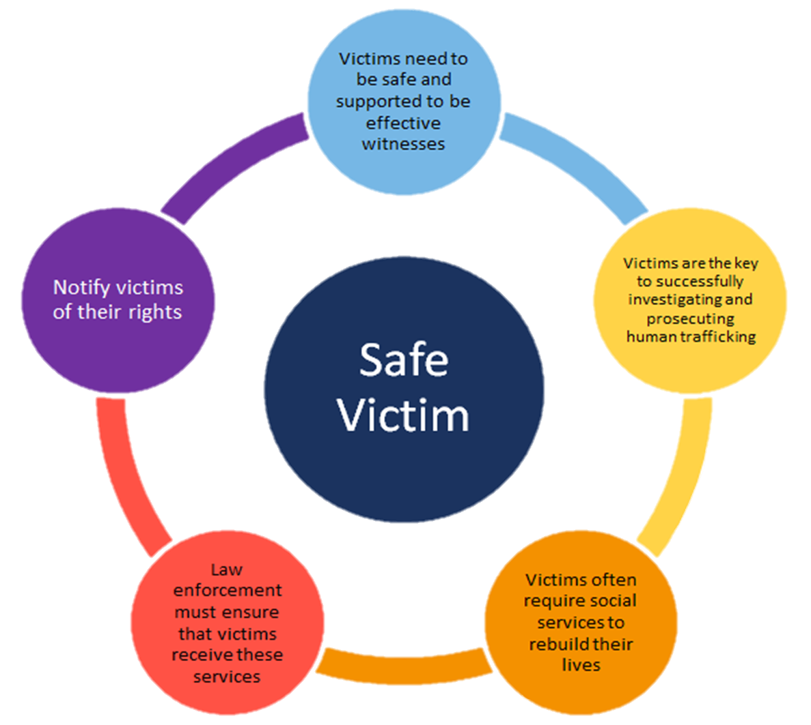

Slide 77
Advocates as Social Change Agents
Important to look at what may or may not be working well for victims.
As advocates, look at the other agencies and programs that have key roles in responding to victims.
What is needed to strengthen advocacy program relationships with those agencies and programs?
Is there a team, an organized collaborative response that is addressing sex trafficking?
If not, what would it take to develop such a team?
What is your organization’s capacity to build such a team?
Who are your allies and is there a strong partnership with these people/organizations?

Slide 78
Establishing and Maintaining Trust
Provide as many safety measures as possible;
Inform victims of their rights and options so they can make informed decisions;
Address basic needs (food, clothing, housing);
Do not duplicate the tactics used by traffickers (appearing forceful, pressuring victim to make decisions, making a victim feel indebted to you as a way to manipulate their actions, etc.);
Keep victim informed of case status if there is criminal justice involvement;
Make sure the victim knows that you respect their decision-making process;

Slide 79
Establishing and Maintaining Trust
Takes time and patience;
Acknowledge the harm caused;
Inform them of what will be done with information they are providing;
Who will see the information and why;
Avoid taking the victim’s reluctance to divulge information personally;
Check in with victim from time to time; and
If appropriate, let victim know you are thinking of them so they remember they can call if they need to.

Slide 80
Why Victims May Fear Accessing Services
Fear of not being believed
Lack of knowledge of the processes
Fear of confidentiality violations
Fear of rumors and misperceptions
Distrust of criminal justice system
Fear of being arrested and jailed
Fear of having to testify against the perpetrator

Slide 81
Why Victims May Fear Accessing Services
Victims may be worried about the criminal record that results from being convicted and if prosecution for involvement in commercial sex industries can act as a barrier to future employment, housing, and other opportunities.

Slide 82
Large Group Demonstration
Finding Services

Slide 83
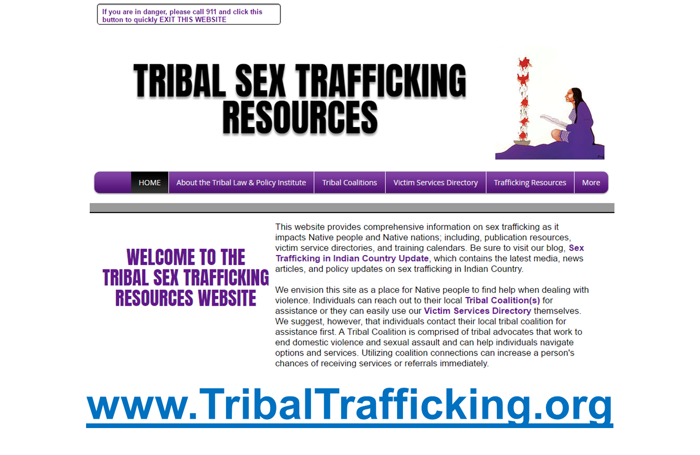
Large Group Demonstration

Slide 84
Remember Poem
Remember…We are here to listen,
Not to work miracles.
We are here to help “victims” discover
What they are feeling
Not to make the feelings go away.
We are here to help “victims” identify their options.
Not to decide for them what they should do.

Slide 85
Remember Poem
We are here to discuss steps with them.
Not to take steps for them.
We are here to help victims discover they can help themselves.
Not to rescue them leaving them still vulnerable.
⎯Anonymous

Slide 86
Additional Resources
Notes:
This slide is intentionally left blank to allow the facilitator to customize to their community.

Slide 87
Additional Resources
Notes:
This slide is intentionally left blank to allow the facilitator to customize to their community.

Slide 88
Questions?

Slide 89
Legal Advocacy
Sex Trafficking in Indian Country: Advocacy Curriculum | Unit 4
Prepared by the Tribal Law and Policy Institute
This resource was supported by Grant No. 2013-TA-AX-K025, awarded by the Office on Violence Against Women, U.S. Department of Justice. The opinions, findings, conclusions, and recommendations expressed in this
publication/program/exhibition are those of the author(s) and do not necessarily reflect the views of the Department of Justice, Office on Violence Against Women.
Sex Trafficking in Indian Country: Advocacy Curriculum | Unit 4 | Tribal Law and Policy Institute | 89

Slide 90
Training Agenda
Introductions, Agenda, Overview of Unit, and Learning Objectives
“Meeting Legal Advocacy Needs of Victims” – Small Group Exercise
Victim Advocacy Roles
Legal Advocacy Responsibilities
“Meeting the Legal Needs of Victims” – Small Group Exercise
Overview of Legal Needs in Criminal Systems
Overview of Legal Needs in Civil Systems
Navigating Criminal Jurisdiction In Indian country
Criminal Legal Advocacy
Victim’s Rights
Navigating Civil Jurisdiction in Indian country
Civil Legal Advocacy
Civil Protection Orders
Enforcing Tribal Protection Orders
Full Faith and Credit
Advocate’s PO Checklist
Question and Answer

Slide 91
Learning Objectives
  As a result of participating in this workshop you will be better able to:
  Identify critical roles advocates fill when providing advocacy;
  Identify legal advocacy needs of sex trafficking victims;
  Identify concerns related to victim information;
  Identify potential needs of victims in criminal systems;
  Identify potential needs of victims in civil systems;
  Identify victim’s rights and explain the importance of each; and
  Identify important issues regarding tribal protection order issuance and enforcement.

Slide 92
Small Group Exercise
Meeting the Legal Advocacy Needs of
Sex Trafficking Victims

Slide 93
Small Group Exercise
List 3 possible concerns victims may have about interacting with legal systems.
With each concern, brainstorm how an advocate might address those in a realistic but supportive way.

Slide 94
Victim Advocacy Roles
  Victim advocate’s role is to act as the BIASED supporter of Indian women experiencing violence and advocate for the victim’s EXPRESSED interests.

Slide 95
Victim Advocacy Roles
  Direct Victim Advocacy
  Emotional and Family Support
  Community and Collaborator Accountability
  Legal System Advocacy

Slide 96
Legal Advocacy Responsibilities
Legal advocacy may involve either or both the civil and criminal justice system, depending on the victim’s wishes. Both justice systems can be confusing for victims and as such, the advocate should be there to guide the victim through those systems. The advocate does this by providing accurate information about what the victim can expect and support the victim’s decisions throughout the process.

Slide 97
Legal Advocacy Responsibilities
Protecting victim information;
Providing emotional support;
Help victims with safety planning;
Assisting a victim with obtaining a protection order (in both civil and criminal system);
Providing information on victim’s rights (in the criminal justice system);
Accompanying victim as needed and requested to hearings, trial, and appointments;
Working with other advocates involved in the case;
Monitoring case for compliance with policies, protocols, codes;
Providing follow up on cases as needed and appropriate; and
Educating service providers.

Slide 98
Legal Advocacy Responsibilities
  Protecting Victim Information
  Accompanying the Victim in the Courtroom

Slide 99
Protecting Victim Information
  Community based (grassroots);
  Hospital based;
  Prosecutor based; and
  Law enforcement based.

Slide 100
Protecting Victim Information
Privacy
Confidentiality
Privilege

Slide 101
Protecting Victim Information - Privacy
Privacy is the expectation that when a victim shares information with another individual (the individual does not have to be a professional), the information will go no further without the victim’s consent.

Slide 102
Protecting Victim Information - Confidentiality
Protecting the confidentiality of communications is an ethical duty to keep the victim’s information private. Victim statements are meant only for the service provider and the information may only be disclosed with client consent. If the service provider discloses the victim’s information without the victim’s consent, the service provider may be liable for an ethical breach of duty and lose any of their licensure or certifications.

Slide 103
Protecting Victim Information - Confidentiality
Types of information that are usually confidential include:
Name/address of client requesting services;
Name/address of client receiving services;
Other private, identifying information about client (telephone number, birthdate, health issues, etc.);
Location of victim; and
Domestic violence shelter location.

Slide 104
Protecting Victim Information - Confidentiality
The victim’s permission to disclose certain victim information should be executed in a written release of information form that:
Lists what specific information you can disclose;
Identifies whom the information can be disclosed to;
Is signed by the client;
Includes an expiration date; and
Provides notice that the client can rescind their permission at any time if they choose.

Slide 105
Protecting Victim Information - Privilege
A privilege is an evidentiary rule that prevents the disclosure of information, even if relevant, in court. Particularly, privilege can come into play when the information was originally communicated in a professional or confidential relationship that is covered by law.

Slide 106
Protecting Victim Information - Privilege
Privileges that protect victim information from disclosure are usually set out in statutes or case law in the applicable jurisdiction.
A disclosure of the privileged information may have legal and/or criminal consequences.
Note, it is a best practice to have a tribal code that directly sets forth that communications between the victim and the advocate providing services are privileged and not subject to disclosure, absent court orders or statutory mandate.

Slide 107
Victim Advocacy in the Courtroom
– Safety Planning
Victims may have a false sense of security going to court.
Victims may feel like they can let their guard down.
Violent outbursts can happen anywhere.

Slide 108
Victim Advocacy in the Courtroom
– Safety Planning
Learn as much about the perpetrator as possible, particularly if the advocate has not seen them before.
Request law enforcement accompany the victim and advocate to the courthouse and courtroom.
Inquire about the presence of cameras in the parking lot. Park near cameras and closest entrances to the courtroom.

Slide 109
Victim Advocacy in the Courtroom – Courtroom Decorum
Remember to demonstrate a deep respect for the sovereign (federal, state, or tribal);
Do your homework prior to appearing in court; and
Determine whether the trial or hearing will be a bench trial or jury trial.
Tip: Visit and observe the court in session with the judge presiding that will hear the victim’s case.

Slide 110
Victim Advocacy in the Courtroom
Be on time for court and urge the victim to be on time;
  Tell them to show up at least 30 minutes before the scheduled time.
Make sure there is a safe and private place to wait for the case to be called;
Dress respectfully; and
Stand when speaking to the Judge.

Slide 111
Victim Advocacy in the Courtroom
DO NOT bring confidential information with you to court unless court ordered (not a subpoena duces tecum) to do so.
  This is critical as any documentation that is brought to court is subject to discovery!
DO NOT discuss the case while on the courthouse grounds.
  It is amazing how many ears are in very private places on the courthouse grounds!

Slide 112
Victim Advocacy in the Courtroom
BEWARE OF THE UNAUTHORIZED PRACTICE OF LAW!
Be clear that you are the victim advocate, and not the victim’s lawyer.

Slide 113
Small Group Exercise
Meeting the Legal Needs of
Sex Trafficking Victims

Slide 114
Small Group Exercise
What are the legal needs of a sex trafficking victim?
Identify civil and/or criminal legal needs with your small group.

Slide 115
Overview of Legal Needs in Criminal Systems
In criminal legal systems, sex trafficking victims will need assistance with preparation for trial, seeking a criminal no contact order, asserting victim’s rights, and preparing and delivering victim impact statements.

Slide 116
Overview of Legal Needs in Criminal Systems
The victim’s own criminal case
    Affirmative defenses, immunity from prosecution, expungements.
The trafficker’s criminal case
    Filing a police report, witness statements, trial accompaniment, victim’s rights, protection orders, and general advocacy.

Slide 117
Overview of Legal Needs in Civil Systems
In civil legal systems, a civil legal remedy is simply using the law or authority of the court to enforce a legal right or other legal relief to the victim. Victim compensation and protection orders are types of legal relief.

Slide 118
Overview of Legal Needs in Civil Systems
Employment law;
Tort law;
Housing laws;
Debtor/creditor law;
Family law;
Domestic violence law;
Children’s civil legal needs; and
Protection orders.

Slide 119
The Basics of Civil and Criminal Jurisdiction
Criminal jurisdiction refers to the power of a court to prosecute a crime. Criminal cases are initiated by governments; Native Nations, states, or the federal government may be the prosecuting party. Those found guilty of a crime may be incarcerated and/or fined.
Civil jurisdiction generally refers to the power of a court to handle lawsuits or actions between two private persons or parties. Generally, there is no risk of incarceration in a civil lawsuit.

Slide 120
Civil and Criminal Jurisdiction
Subject matter jurisdiction generally refers to a court’s authority over a particular type of case.
Personal jurisdiction refers to a court’s authority over specific people. Not all cases require personal jurisdiction as a prerequisite to a court exercising jurisdiction. And, individuals can consent to a court’s jurisdiction.

Slide 121
Navigating Criminal Jurisdiction in Indian country
Three sovereigns may be involved in sex trafficking cases involving Native people: tribes, federal government, and states.
Generally, Native Nations that create tribal trafficking laws will be able to prosecute Indian sex traffickers within the limits of their tribal criminal jurisdiction.

Slide 122
Navigating Criminal Jurisdiction in Indian country
In tribal court, the question of which sovereign(s) may have jurisdiction over a crime is a complex one that asks a series of subquestions:
    Was the perpetrator Indian or non-Indian?
    Was the victim Indian or non-Indian?
    What was the crime?
    Where did the crime occur?
The Indian law jurisdictional analysis provided above will apply only to crimes being prosecuted in tribal court.

Slide 123
Criminal Legal Advocacy
Victims can enter the criminal justice system in one of two ways: being charged with a crime or being the victim of a crime.
Victims fear possible arrest and criminal prosecution resulting from reporting sex trafficking.

Slide 124
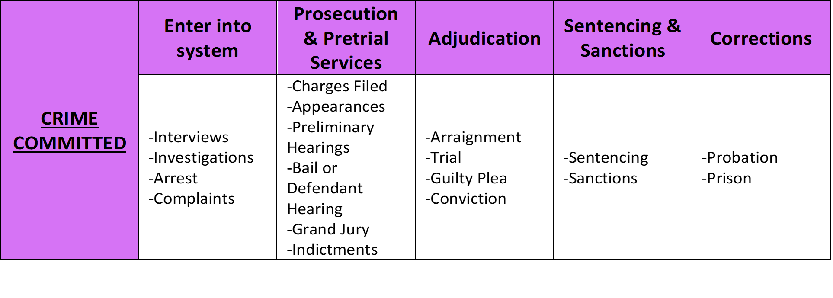
Overview of the Criminal Process

Slide 125
Victim’s Rights Laws
  Every state (plus Washington, D.C., and several territories) has created a body of law granting basic rights and protections for victims of crimes during the criminal process.
  Access to victim’s rights laws are important because they ensure that victims are informed of, and allowed to participate in, state and federal criminal processes.
  Several Native Nations have victim’s rights laws.

Slide 126
Victim’s Rights Laws
  Generally, sex trafficking victims’ rights may include the following:
  Right to attend hearings;
  Right to compensation;
  Right to be heard; and
  Right to be informed.

Slide 127
Victim’s Rights Laws
  Generally, sex trafficking victims’ rights may include the following:
  Right to privacy;
  Right to protection;
  Right to restitution;
  Right to return of property;
  Right to a speedy trial; and
  Right to enforcement/remedies.

Slide 128
Navigating Tribal Civil Jurisdiction
For tribal civil matters arising in Indian country on tribal lands, it is well settled that tribes have the power to issue civil tribal protection orders in matters involving tribal members.
VAWA 2013 also directly endorses tribal civil jurisdiction over all persons when issuing tribal protection orders when matters arose in Indian country or otherwise was within the authority of the tribe.

Slide 129
Navigating Tribal Civil Jurisdiction
Tip: It is important for advocates to consult the tribal constitution and codes of the tribe to determine how the laws of the tribe exercising civil jurisdiction over a type of case sets jurisdictional parameters. The advocate may need to consult with a legal expert, preferably one familiar with federal Indian law and the tribal court at issue.

Slide 130
Civil Legal Advocacy
Because many common civil legal needs will require specialized legal expertise, an advocate should:
Know your local civil legal resources and their intake processes;
Refer your clients;
Accompany your client to initial appointments; and
Advocate for your client’s rights with their service providers and civil legal systems.

Slide 131
Civil Legal Advocacy
Because they eventually may be subpoenaed, be careful about discussing possible civil lawsuits with victims.
Advise victims about how to find competent and caring civil attorneys.
Always give moral support!

Slide 132
Civil Legal Advocacy

Slide 133
Civil Protection Orders
A protection order is a legal document that is available to victims of violence in most jurisdictions; a legal order issued by a court to protect the named person(s) from another person.
Defined under federal law 18 U.S.C. §2266(5).

Slide 134
Civil Protection Orders
Ex parte orders can be issued without a full hearing if the victim can demonstrate immediate danger. Ex parte orders are available in most jurisdictions in emergency situations, but only last for a short period.
Permanent orders can be issued after the defendant has been provided with notice and an opportunity to be heard. Most “permanent” protection orders will have an expiration date that is set forth by statutes in the issuing jurisdiction.

Slide 135
Enforcing Tribal Protection Orders
Congress clarified in the Violence Against Women Act 2013 Reauthorization (VAWA) that tribal courts have full jurisdiction over all parties in protection order cases if the protection order arose in Indian country or otherwise within the authority of the Indian tribe.
These protection order provisions apply to every tribe, including those in Alaska.

Slide 136
Enforcing Tribal Protection Orders
For a Native Nation to issue and enforce protection orders, VAWA requires that:
The matter must have arisen on tribal land,
OR
2. The matter must be within the authority of the Indian tribe.
*VAWA provides for civil enforcement remedies against
any person that violates a tribal protection order.

Slide 137
Full Faith and Credit
The protection order is enforced in every jurisdiction as the order is written.

Slide 138
Full Faith and Credit 18 U.S.C. §2265(a)
“Any protection order that is consistent with subsection (b) of this section by the court of one State, Indian tribe or territory (the issuing State, Indian tribe, or territory) shall be accorded full faith and credit by the court of another State, Indian tribe, or territory (the enforcing State, Indian tribe, or territory) and enforced by the court and law enforcement personnel of the other State, Indian tribal government or Territory as if it were the order of the enforcing State, Indian tribe, or territory.”

Slide 139
Protection Orders under VAWA 18 U.S.C. §2265(b)
(b) Protection Order. A protection order issued by a state, tribal, or territorial court is consistent with this subsection if—
1. Such court has jurisdiction over the parties and matter under the law of such state, Indian tribe, or territory; and
2. Reasonable notice and opportunity to be heard is given to the person against whom the order is sought sufficient to protect that person’s right to due process. In the case of ex parte orders, notice and opportunity to be heard must be provided within the time required by State, tribal, or territorial law, and in any event within a reasonable time after the order is issued, sufficient to protect the respondent’s due process rights.

Slide 140
Advocate’s Tribal Protection Order Checklist
Advocates should ensure that Tribal Protection Orders are enforceable across jurisdictions. The Advocate’s Tribal Protection Order Checklist in Unit 4 and the Comprehensive Tribal Protection Order Checklist in the Participant Workbook appendix serve as helpful reminders of what to include.
Each jurisdiction is different and best practices and laws change, so be sure to create and maintain a checklist that works for your clients and jurisdiction.

Slide 141
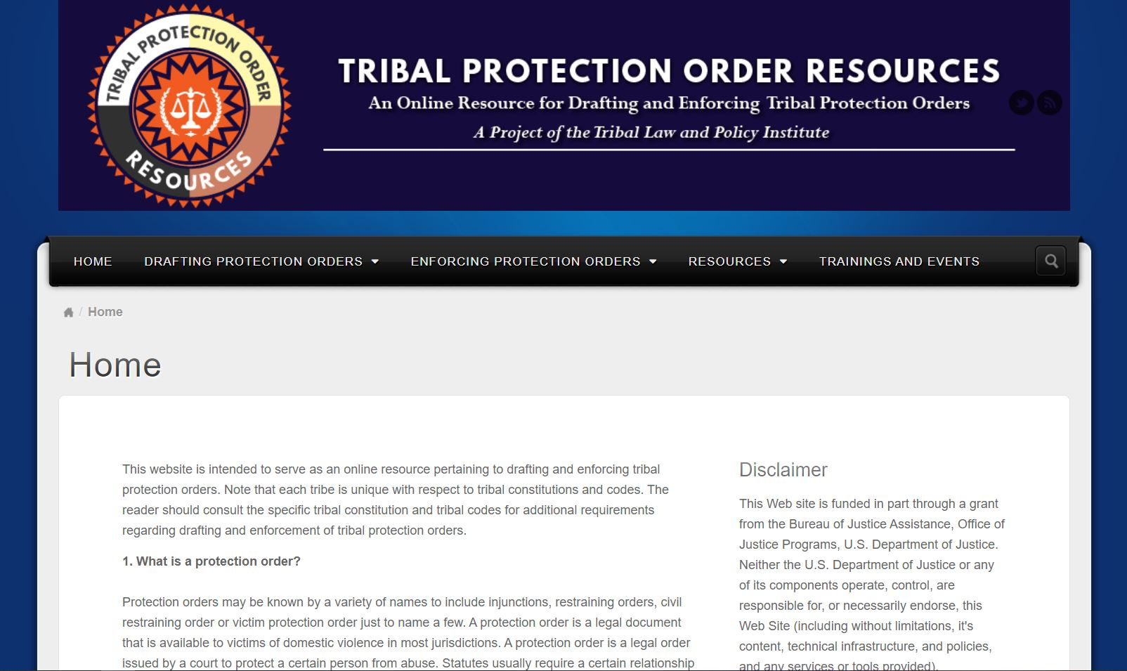
Tribal Protection Order Resources
www.TribalProtectionOrder.org

Slide 142
Additional Resources
Notes:
This slide is intentionally left blank to allow the facilitator to customize to their community.

Slide 143
Questions?

