Slide 1
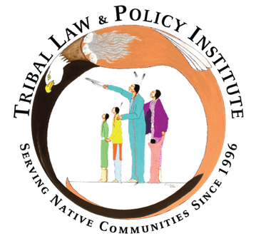
Sex Trafficking in Indian Country Introduction to Advocacy Curriculum Webinar Wednesday Series
Wednesday, October 14, 2020
Prepared by the Tribal Law and Policy Institute
in collaboration with the Minnesota Indian Women’s Sexual Assault Coalition
Notes:
Thank you for joining the first webinar in our webinar series on the Sex Trafficking in Indian Country in Advocacy Curriculum. A publication brought to you by – MIWSAC and TLPI.
Abby

Slide 2
Friendly Housekeeping Reminders
Your control panel will appear at the bottom of your user screen. (As shown below)
All attendees will be muted during the presentation.
Use the Chat box to submit a comment to “All Presenters” or “Presenters & Everyone”
If you have a question, please type it in the Q&A box.
Please complete the evaluation survey, a link will be loaded in the chat box. The survey will also popup in your web browser when the session ends.
This session is being recorded.
Notes:
Abby
Heather: drop eval link in the chat box

Slide 3
Introductions of Presenters and Tech Support
Bonnie Clairmont, Victim Advocacy Specialist
Kelly Gaines Stoner, Victim Advocacy Legal Specialist
Heather Torres, Program Director
Abby Thoennes, Program Assistant
Notes:
Abby
Bonnie
Kelly
Heather

Slide 4
Webinar Agenda
History of Curriculum
How the Curriculum Works
Overview of Each Unit and Highlights of Unit 1
Finding Services on Website – www.tribaltrafficking.org
Overview of Upcoming Webinars and Registration Information
Q & A
Notes:
Heather T

Slide 5
Poll Question
Do you believe sex trafficking is a problem in your community?
Notes:
Heather will read question.
Abby will launch poll.
Bonnie will discuss results.

Slide 6
History of the Curriculum: A Long and Winding Road
Notes:
Kelly
Years in the making…
OVW grant funding from TA solicitation Targeted Purpose Area 28: Provide training and technical assistance to Tribal Domestic Violence and Sexual Assault Coalitions to increase the coalitions’ capacity to address sexual assault in tribal communities and to increase their knowledge and understanding of sex trafficking and how to address the issue.
Started October 2014
Target audience were the 18 tribal coalitions
Development of website which is www.tribaltrafficking.org and the Sex Trafficking in Indian Country Curriculum.
Later, the Minnesota Indian Women’s Sexual Assault Coalition contracted with TLPI to pilot test the Curriculum, make edits, and maintain www.tribaltrafficking.org.
Today, contracting with the Minnesota Indian Women’s Sexual Assault Coalition to train on the Curriculum, complete edits to the previous legal issues units, and maintain www.tribaltrafficking.org.

Slide 7
Dedicated to Tribal Coalitions in honor of their dedication and tireless efforts to advance system change for victims and for training tribal advocates and others seeking to promote safety for all victims of domestic violence, sexual assault, dating violence, stalking and sex trafficking
Notes:
Bonnie

Slide 8
Pilot Testing of Curriculum
Why pilot test?
The curriculum originally contained an advocacy issues curriculum and a legal issues curriculum.
Albuquerque, NM – Advocacy Issues Curriculum
Coachella Valley, CA – Legal Issues Curriculum
Evaluations were compiled and Units were revised based on the evaluations.
Notes:
Heather
Why pilot test?
Who were part of the pilot tests??

Slide 9
Pilot Testing of Curriculum
Focus should be on advocacy, a resource for advocates.
A legal advocacy unit was added into the advocacy issues curriculum. Currently, Unit 4.
The legal issues curriculum focused on sex trafficking laws at the tribal, state, and federal level.
That curriculum is now in the process of being reworked into a supplemental reading to support the Advocacy Curriculum. Stay posted!!
Notes:
Heather
Takeaways from the pilot testing and community feedback…
The need, the focus should really be on advocacy and advocacy skills
Announce that the supplemental reading in progress

Slide 10
How the Curriculum Works: The Purpose
To provide an easily accessible, interactive training tool that tribal coalitions can utilize to train service providers such as advocates and others that work within tribal programs that may serve victims of sex trafficking;
To provide a basic understanding of sex trafficking as it impacts Native people. The information will assist you to understand what constitutes sex trafficking from both a general legal perspective as well as from a tribal advocate’s perspective;
To educate on misconceptions and attitudes that may keep victims from reaching out for help; and
To address risk factors associated with sex trafficking victimization and also will promote an understanding of why sex trafficking has become a pervasive problem in tribal communities.
Notes:
Kelly

Slide 11
How the Curriculum Works: 3 Parts
Instructor Guide –contains resources and guidance to presenters of workshops, conferences, staff trainings or community trainings; how to conduct interactive exercises.
Participant Workbook- a resource for participants attending trainings or engaging in self-study.
PowerPoints- corresponds with the Instructor Guide and Participant Workbook.
Notes:
Kelly
Powerpoints can be a powerful learning tool. It was important to provide the editable presentation in order for local trainers to insert local additional resources and to customize exercises for their teams.
How all 3 parts work together. In future webinars, we will be running through each Unit in the Participant Workbook with some limitations on exercises due to time and the volume of interest in the webinars.

Slide 12
Sex Trafficking in Indian Country: Advocacy Curriculum Contains 4 Units
Unit 1 - Introduction to Sex Trafficking in Indian Country
Unit 2 - Identifying and Screening for Sex Trafficking
Unit 3 - Advocacy for Victims of Sex Trafficking
Unit 4 - Legal Advocacy
Notes:
Kelly

Slide 13
Units Include
Tips for Presenters (In the Instructor Guide)
Training needs (In the Instructor Guide)
Small Group Exercises
Videos and discussion
Additional Resources
Q & A
Notes:
Kelly

Slide 14
Overview of Unit 1
This unit was designed to enable the trainer to provide a basic understanding of sex trafficking of adults and minors existing in the United States and Indian country. The information will assist the participants to understand what constitutes human sex trafficking from both a general legal perspective as well as from a tribal advocate’s perspective, understand some of the misconceptions and attitudes that may keep victims from reaching out for help and have a better understanding of why sex trafficking is such a pervasive problem in tribal communities. This unit will also expose the participants to various risk factors associated with sex trafficking victimization.
Notes:
Bonnie

Slide 15
Unit 1 – Introduction to Sex Trafficking in Indian Country, Training Agenda
Welcome, Invocation, Introduction, and Housekeeping
Overview of Unit and Learning Objectives
“Training Expectations”—Large Group Exercise
What Is Sex Trafficking?
Advocate’s Working Definition
Common Misconceptions
“Anything of Value”—Small Group Exercise
“No Force, Fraud, or Coercion Required”—Large Group Exercise
Where Does Sex Trafficking Occur?
Why Does Sex Trafficking Occur?
Question and Answer
Notes:
Bonnie
Example training agenda

Slide 16
Highlights of Unit 1
Common Misconceptions
Colonization and Sex Trafficking
Exercise: Anything of Value
Systemic Change to a System Problem
Notes:
Bonnie

Slide 17
Common Misconceptions
Sex trafficking must involve kidnapping, confinement, or physical force.
Sex trafficking must involve travel across state or international boundaries.
Traffickers are always strangers to the victim.
Sex trafficking victims are always female.
Getting paid any amount means an individual cannot also be a victim.
Victims are eager to receive help, self-identify, and discuss their victimization.
Domestic violence is always different from sex trafficking.
Sex trafficking always involves the exchange of money.
Notes:
Bonnie

Slide 18
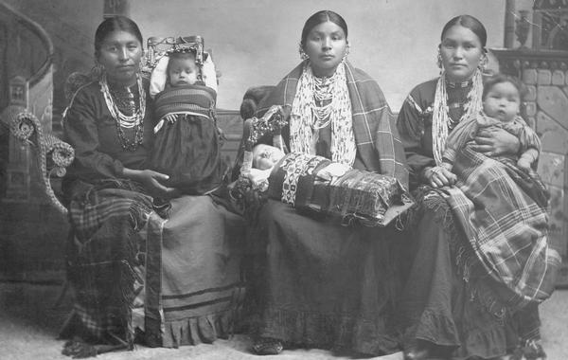
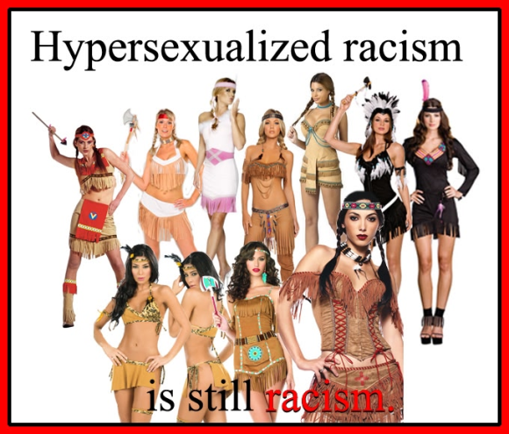
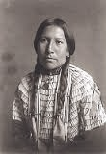
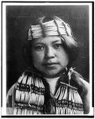
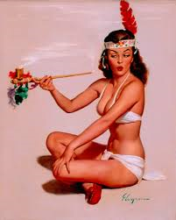
Colonization and Sex Trafficking
Colonization
Notes:
Bonnie

Slide 19
Small Group Exercise
Anything of Value
Notes:
Bonnie

Slide 20
Systemic Change to a Systemic Problem
Contemporary sex trafficking as a symptom of colonization
Advocates must address societal norms and attitudes
Identify and dismantle systems that support traffickers
Look to traditional community values that can be used to support antitrafficking efforts
Notes:
Bonnie

Slide 21
Overview of Unit 2
This unit will provide tools and information that would enable proper and early identification of potential victims of sex trafficking to develop a victim-centered, culturally appropriate response. Emphasize the importance of understanding trafficker behaviors and the methods used to keep victims trapped.
Notes:
Bonnie

Slide 22
Unit 2 – Identifying and Screening for Sex Trafficking, Training Agenda
Introductions, Agenda, Overview of Unit, and Learning Objectives
“Identifying Sex Trafficking”—Video and Large Group Discussion
Who Are Sex Traffickers?
What Do Traffickers Look For?
Risk Factors
Types of Sex Trafficking
Tactics Used by Traffickers
Correlations to Domestic Violence
Sex Trafficking Red Flags
“Fact Patterns”—Small Group Exercise
Interviewing a Victim
Initial Safety Assessment
Screening Tools
“Developing a Culturally Appropriate Screening Tool”—Small Group Exercise
Question and Answer
Notes:
Bonnie

Slide 23
Overview of Unit 3
This unit will provide participants with practical tips and guidance for effective advocacy on behalf of sex trafficking victims.
Notes:
Bonnie

Slide 24
Unit 3 – Advocacy for Victims of Sex Trafficking, Training Agenda
Introductions, Agenda, Overview of Unit, and Learning Objectives Using the Medicine Wheel: The Impact of Trauma
“How Might Trauma Impact a Person as a Whole?”—Small Group Exercise
Victim’s Service, Safety, and Long-Term Needs
Establishing and Maintaining Trust
Why Victims May Fear Accessing Services
“Finding Services”—Large Group Demonstration
Remember Poem
Question and Answer
Notes:
Bonnie

Slide 25
Overview of Unit 4
This unit provides basic information to advocates and others regarding the civil and legal needs that a sex trafficking victim might encounter. Includes basic legal terminology and Indian country jurisdictional issues that an advocate might be required to navigate.
Notes:
Kelly

Slide 26
Unit 4 – Legal Advocacy, Training Agenda
Introductions, Agenda, Overview of Unit, and Learning Objectives
“Meeting Legal Advocacy Needs of Victims” – Small Group Exercise
Victim Advocacy Roles
Legal Advocacy Responsibilities
“Meeting the Legal Needs of Victims” – Small Group Exercise
Overview of Legal Needs in Criminal Systems
Overview of Legal Needs in Civil Systems
Navigating Criminal Jurisdiction In Indian country
Criminal Legal Advocacy
Victim’s Rights
Navigating Civil Jurisdiction in Indian country
Civil Legal Advocacy
Civil Protection Orders
Enforcing Tribal Protection Orders
Full Faith and Credit
Advocate’s PO Checklist
Question and Answer
Notes:
Kelly

Slide 27
Finding Services – www.tribaltrafficking.org
Notes:
Bonnie
Switch to website – start at homepage and then Victim Services Directory

Slide 28
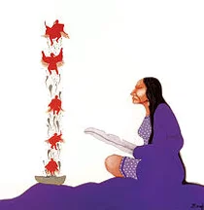
Download the Sex Trafficking in Indian Country: Advocacy Curriculum
https://www.home.tlpi.org/sex-trafficking
or visit
https://www.tribaltrafficking.org/sex-trafficking-advocacy-curriculum
Notes:
Bonnie

Slide 29
Webinar Wednesday Series
Wednesday, October 14: Introduction to Advocacy Curriculum (90 min)
Wednesday, October 28: Unit 1 - Introduction to Sex Trafficking in Indian Country (90 min)
Wednesday, November 11: Unit 2 - Identifying and Screening for Sex Trafficking (105 min)
Wednesday, November 25: Unit 3 - Advocacy for Victims of Sex Trafficking (90 min)
Wednesday, December 9: Unit 4 - Legal Advocacy, Part I (90 min)
Wednesday, December 23: Unit 4 - Legal Advocacy, Part II (90 min)
All webinars will begin at 11:00am PT/12:00pm MT/1:00pm CT/2:00pm ET.
Register for the Webinar Wednesday Series on Zoom: https://rb.gy/rhdef2
Notes:
Abby
Drop registration link in chat box.
These are the remaining webinars in our series.
Due to the virtual forum and volume of interest, we may not be able to get through all the exercises. We recommend running through all exercises with your teams, communities, families post-webinar.

Slide 30
Questions?
Bonnie Clairmont, Victim Advocacy Specialist, bonnie@tlpi.org
Kelly Gaines Stoner, Victim Advocacy Legal Specialist, kelly@tlpi.org

