Slide 1
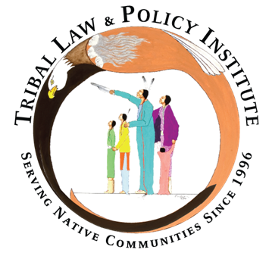

Sex Trafficking in Indian Country, Legal Advocacy, Part II
Webinar Wednesday Series
Wednesday, December 23, 2020
Prepared by the Tribal Law and Policy Institute
in collaboration with the Minnesota Indian Women’s Sexual Assault Coalition
This resource was supported by Grant No. 2013-TA-AX-K025, awarded by the Office on Violence Against Women, U.S. Department of Justice. The opinions, findings, conclusions, and recommendations expressed in this publication/program/exhibition are those of the author(s) and do not necessarily reflect the views of the Department of Justice, Office on Violence Against Women.
Notes:
Abby

Slide 2




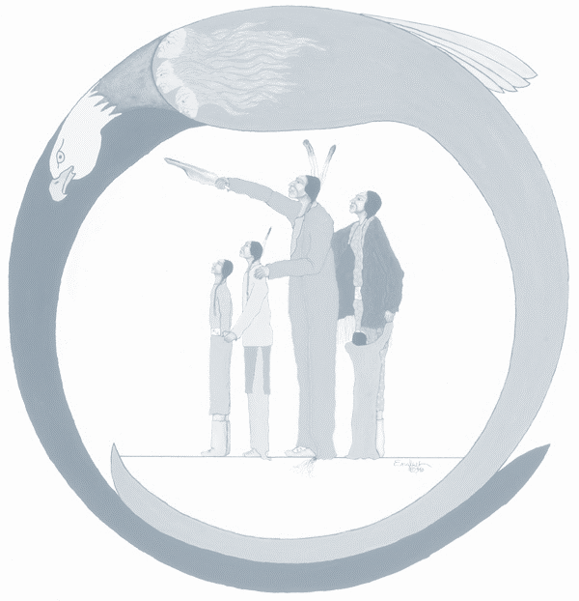
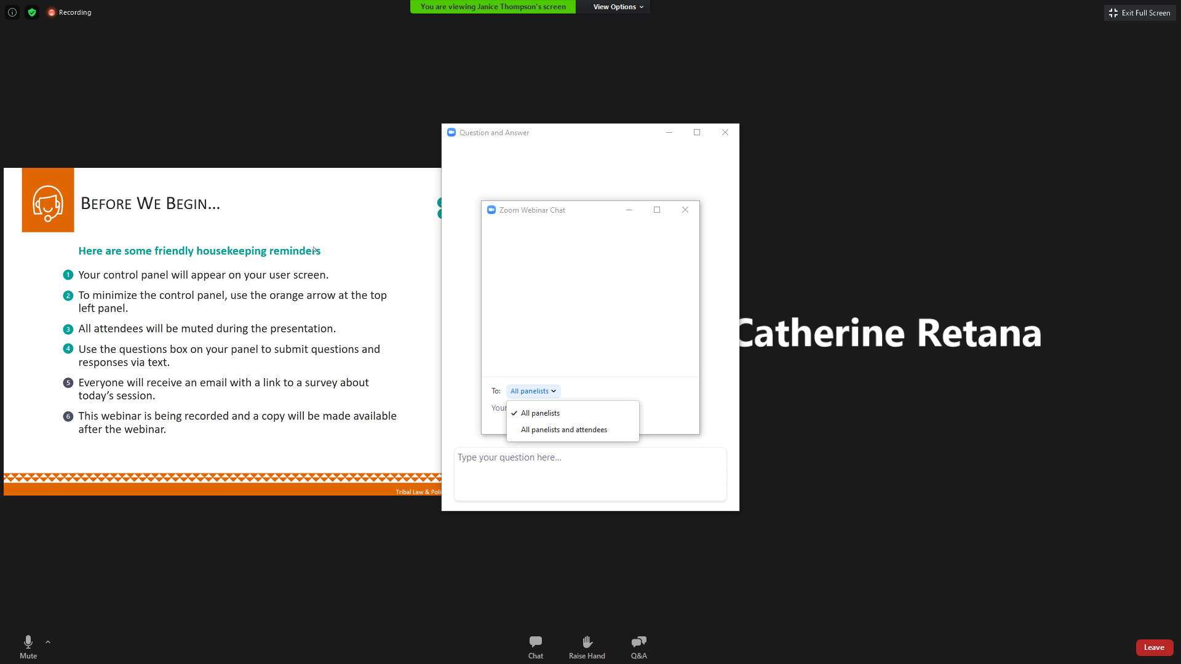
Friendly Housekeeping Reminders
Your control panel will appear at the bottom of your user screen. (As shown below)
All attendees will be muted during the presentation.
Use the Chat box to submit a comment to “All Presenters” or “Presenters & Everyone”
If you have a question, please type it in the Q&A box.
Please complete the evaluation survey, a link will be loaded in the chat box at the end of the webinar.
  The survey will also popup in your web browser when the session ends.
  It will also be in the follow-up email you receive from Zoom following the webinar.
This session is being recorded. The video will be posted on www.TribalTrafficking.org
Notes:
Abby
Announce that previous videos are also posted.
Certificate of Attendance – all webinars in the series
We have made the videos available for anyone that has missed a previous webinar. Unfortunately, we cannot track those that watch the recordings and are only able to issue a Certificate of Attendance to those that have attended the full length of all the webinars live.
Will be sent out in January.

Slide 3
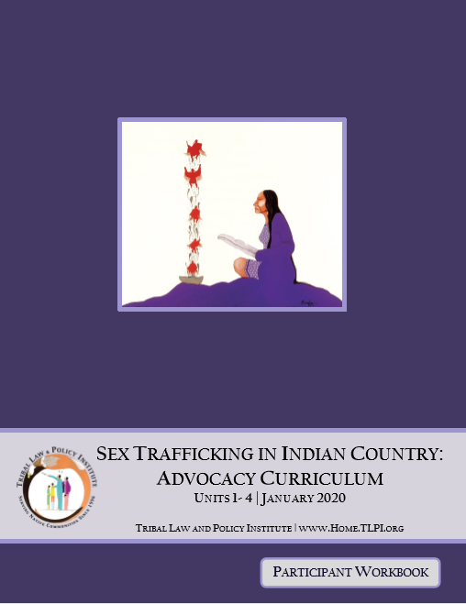
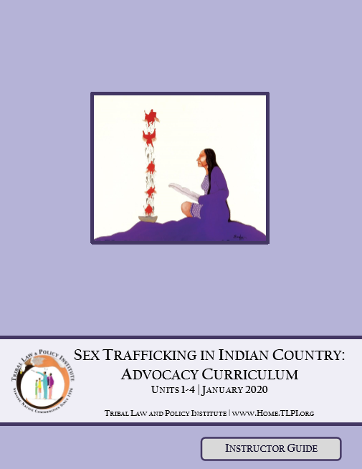
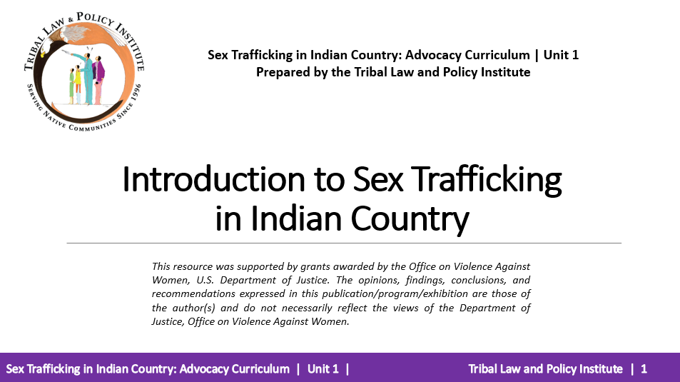
Download the Sex Trafficking in Indian Country: Advocacy Curriculum
https://www.home.tlpi.org/sex-trafficking
or visit
https://www.tribaltrafficking.org/sex-trafficking-advocacy-curriculum
Notes:
Abby

Slide 4
Question from previous webinar - Resources re various Highway Systems
Department of Transportation: "The limited transportation-related human trafficking data available confirms that victims are being trafficked by airplanes, buses, subways, trains, taxis, rideshares, cruise ships, and private vehicles“
  https://www.transportation.gov/sites/dot.gov/files/docs/mission/international-policy-and-trade/against-human-trafficking/338066/acht-draft-final-report.pdf​
Polaris Project Resources
  https://polarisproject.org/human-trafficking-and-the-transportation-industry/ and
  https://polarisproject.org/the-typology-of-modern-slavery/
Transit on the Lookout to Combat Human Trafficking, A Toolkit for Public Transport Agencies in the United States and Canada
  https://truckersagainsttrafficking.org/wp-content/uploads/2020/06/BOTLtoolkit_transit_FINAL.pdf​
Human Trafficking and Mobility of Missing and Murdered Indigenous Women Webinar, Transportation Research Board
  https://3fb28d6f-a96e-45cf-86bb-2bfb9f1b6453.usrfiles.com/ugd/3fb28d_d999505e9d114b4982613bdfd3f9773b.pdf
  https://3fb28d6f-a96e-45cf-86bb-2bfb9f1b6453.usrfiles.com/ugd/3fb28d_f7a0937b32e94150885fb1c6716ed240.pdf
Notes:
Heather
Question: I'd like to see stats re various Hwy systems ...

Slide 5
Training Agenda
Introductions, Agenda, Overview of Unit, and Learning Objectives
“Meeting Legal Advocacy Needs of Victims” – Small Group Exercise
Victim Advocacy Roles
Legal Advocacy Responsibilities
“Meeting the Legal Needs of Victims” – Small Group Exercise
Overview of Legal Needs in Criminal Systems
Overview of Legal Needs in Civil Systems
Navigating Criminal Jurisdiction In Indian country
Criminal Legal Advocacy
Victim’s Rights
Navigating Civil Jurisdiction in Indian country
Civil Legal Advocacy
Civil Protection Orders
Enforcing Tribal Protection Orders
Full Faith and Credit
Advocate’s PO Checklist
Question and Answer
Notes:
Heather
Today is Part II of Unit 4: Legal Advocacy – we will be doing a brief overview of legal needs in both criminal and civil systems and then we will focus on the topics outlined on the right.
What navigating both systems looks like, Victim’s Rights, Civil Protections Orders including enforcement and FFC

Slide 6
Learning Objectives
  As a result of participating in this workshop you will be better able to:
  Identify critical roles advocates fill when providing advocacy;
  Identify legal advocacy needs of sex trafficking victims;
  Identify concerns related to victim information;
  Identify potential needs of victims in criminal systems;
  Identify potential needs of victims in civil systems;
  Identify victim’s rights and explain the importance of each; and
  Identify important issues regarding tribal protection order issuance and enforcement.
Notes:
Heather

Slide 7
Victim Advocacy in the Courtroom
BEWARE OF THE UNAUTHORIZED PRACTICE OF LAW!
Be clear that you are the victim advocate, and not the victim’s lawyer.
Notes:
Kelly

Slide 8
Overview of Legal Needs in Criminal Systems
In criminal legal systems, sex trafficking victims will need assistance with preparation for trial, seeking a criminal no contact order, asserting victim’s rights, and preparing and delivering victim impact statements.
Notes:
Kelly
Throughout the criminal proceedings, advocate needs to be aware of safety needs of victim. Its a given but critically important to mention somewhere.

Slide 9
Overview of Legal Needs in Criminal Systems
The victim’s own criminal case
  Affirmative defenses, immunity from prosecution, expungements, and victim’s rights.
The trafficker’s criminal case
  Filing a police report, witness statements, trial accompaniment, protection orders, and general advocacy.
Notes:
Kelly

Slide 10
Overview of Legal Needs in Civil Systems
In civil legal systems, a civil legal remedy is simply using the law or authority of the court to enforce a legal right or other legal relief to the victim. Victim compensation and protection orders are types of legal relief.
Notes:
Kelly

Slide 11
The Basics of Civil and Criminal Jurisdiction
Criminal jurisdiction refers to the power of a court to prosecute a crime. Criminal cases are initiated by governments; Native Nations, states, or the federal government may be the prosecuting party. Those found guilty of a crime may be incarcerated and/or fined.
Civil jurisdiction generally refers to the power of a court to handle lawsuits or actions between two private persons or parties. Generally, there is no risk of incarceration in a civil lawsuit.
Notes:
Kelly

Slide 12
Civil and Criminal Jurisdiction
Subject matter jurisdiction generally refers to a court’s authority over a particular type of case.
Personal jurisdiction refers to a court’s authority over specific people. Not all cases required personal jurisdiction as a prerequisite to a court exercising jurisdiction. And, individuals can consent to a court’s jurisdiction.
Notes:
Bonnie will do the lead in and Kelly will cover the slide

Slide 13
Navigating Criminal Jurisdiction in Indian country
Three sovereigns may be involved in sex trafficking cases involving Native people: tribes, federal government, and states.
Generally, Native Nations that create tribal trafficking laws will be able to prosecute Indian sex traffickers within the limits of their tribal criminal jurisdiction.
Notes:
Kelly

Slide 14
Navigating Criminal Jurisdiction in Indian country
In tribal court, the question of which sovereign(s) may have jurisdiction over a crime is a complex one that asks a series of subquestions:
  Was the perpetrator Indian or non-Indian?
  Was the victim Indian or non-Indian?
  What was the crime?
  Where did the crime occur?
The Indian law jurisdictional analysis provided above will apply only to crimes being prosecuted in tribal court.
Notes:
Kelly

Slide 15
Question from previous webinar
What is the difference in Prosecuting Trafficking in PL 280 States v. Non-PL 280 States? Is it easier to prosecute?
Notes:
Heather
Link in chat - http://www.tribal-institute.org/lists/pl280.htm
Another comment - I am excited to hear about legal advocacy and the differences between PL-280 states and not a PL-280. I live in MN a mostly PL280 state.
Public Law 83- 280 (commonly referred to as Public Law 280 or PL 280) was a federal statute that transferred legal authority (jurisdiction) from the federal government to state governments which significantly changed the division of legal authority among tribal, federal, and state governments. Before Public Law 280 was enacted, the federal government and Indian tribal courts shared jurisdiction over almost all civil and criminal matters (3) involving Indians in Indian country. The states had no jurisdiction. With the enactment of Public Law 280, affected states received criminal jurisdiction over reservation Indians. Furthermore, Public Law 280 opened state courts to civil litigation that previously had been possible only in tribal or federal courts. Some states have legislated PL-280 like statutes with a similar effect. However, this does not necessarily mean all tribes in the state are covered. Advocates should investigate the legal landscape of their particular state.
Public Law 280 has generally brought about:
- an increased role for state criminal justice systems in "Indian country" (a term which is specifically defined in federal statutes),
- a virtual elimination of the special federal criminal justice role (and a consequent diminishment of the special relationship between Indian Nations and the federal government),
- numerous obstacles to individual Nations in their development of tribal criminal justice systems, and
an increased and confusing state role in civil related matters.
As you can imagine from hearing this baseline information, serving victims in a PL 280 state can have some unique challenges 1) PL 280 diminishes the nation to nation relationship implying attitudes that tribes are not governments or qualified to govern themselves and their lands which can be embodied in state, county or even local bodies which affects responses to violence 2) could lead to misconceptions regarding prevalence of the occurrence of trafficking – with states handling cases or collecting data without coordination with or sharing information with tribes
This makes relationships between state and local agencies of critical importance in PL 280 or PL 280 like states.

Slide 16
Poll Question
Do you provide courtroom advocacy in CRIMINAL cases?
Notes:
Kelly
A: yes or no

Slide 17
Criminal Legal Advocacy
Victims can enter the criminal justice system in one of two ways: being charged with a crime or being the victim of a crime.
Victims fear possible arrest and criminal prosecution resulting from reporting sex trafficking.
Notes:
Bonnie
Can we say Victims may fear possible arrest...?

Slide 18
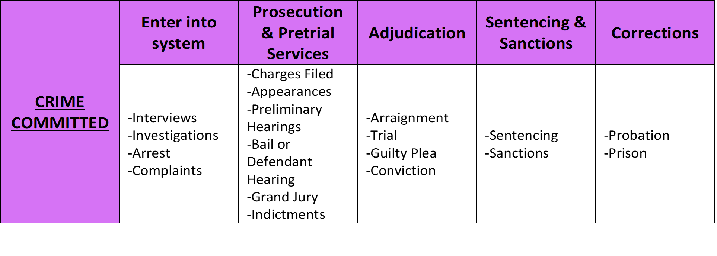
Overview of the Criminal Process
Notes:
Kelly

Slide 19
Victim’s Rights Laws
  Every state (plus Washington, D.C., and several territories) has created a body of law granting basic rights and protections for victims of crimes during the criminal process.
  Access to victim’s rights laws are important because they ensure that victims are informed of, and allowed to participate in, state and federal criminal processes.
  Several Native Nations have victim’s rights laws.
Notes:
Kelly

Slide 20
Victim’s Rights Laws
  Generally, sex trafficking victims’ rights may include the following:
  Right to attend hearings;
  Right to compensation;
  Right to be heard; and
  Right to be informed.
Notes:
Kelly

Slide 21
Victim’s Rights Laws
  Generally, sex trafficking victims’ rights may include the following:
    Right to privacy;
    Right to protection;
    Right to restitution;
    Right to return of property;
    Right to a speedy trial; and
    Right to enforcement/remedies.
Notes:
Kelly

Slide 22
Poll Question
Do you provide courtroom advocacy in CIVIL cases?
Notes:
Kelly
A: yes or no

Slide 23
Navigating Tribal Civil Jurisdiction
For tribal civil matters arising in Indian country on tribal lands, it is well settled that tribes have the power to issue civil tribal protection orders in matters involving tribal members.
VAWA 2013 also directly endorses tribal civil jurisdiction over all persons when issuing tribal protection when matters arose in Indian country or otherwise was within the authority of the tribe.
Notes:
Kelly

Slide 24
Navigating Tribal Civil Jurisdiction
Tip: It is important for advocates to consult the tribal constitutions and codes of the tribe to determine how the laws of the tribe exercising civil jurisdiction over a type of case sets jurisdictional parameters. The advocate may need to consult with a legal expert, preferably one familiar with federal Indian law and the tribal court at issue.
Notes:
Bonnie

Slide 25
Civil Legal Advocacy
Because many common civil legal needs will require specialized legal expertise, an advocate should:
Know your local civil legal resources and their intake processes;
Refer your clients;
Accompany your client to initial appointments; and
Advocate for your client’s rights with their service providers and civil legal systems.
Notes:
Bonnie
BC: I always say prior to making referrals, advocates need to know the individuals in these agencies, by name, types of cases they take and specialize in, etc.

Slide 26
Civil Legal Advocacy
Because they eventually may be subpoenaed, be careful about discussing possible civil lawsuits with victims.
Advise victims about how to find competent and caring civil attorneys.
Always give moral support!
Notes:
Kelly go over slide then toss over to Bonnie

Slide 27
Civil Legal Advocacy
Notes:
Kelly

Slide 28
Poll Question
Do you provide advocacy outside of your tribal jurisdiction?
Notes:
Kelly
Answer: yes or no

Slide 29
Civil Protection Orders
A protection order is a legal document that is available to victims of violence in most jurisdictions; a legal order issued by a court to protect the named person(s) from another person.
Defined under federal law 18 U.S.C. 2266(5).
Notes:
Kelly

Slide 30
Civil Protection Orders
Ex parte orders can be issued without a full hearing if the victim can demonstrate immediate danger. Ex parte orders are available in most jurisdictions in emergency situations, but only last for a short period.
Permanent orders can be issued after the defendant has been provided with notice and an opportunity to be heard. Most “permanent” protection orders will have an expiration date that is set forth by statutes in the issuing jurisdiction.
Notes:
Kelly

Slide 31
Poll Question
Do outside jurisdictions enforce tribal protection orders?
Notes:
Kelly
Answer: yes or no

Slide 32
Enforcing Tribal Protection Orders
Congress clarified in the Violence Against Women Act 2013 Reauthorization (VAWA) that tribal courts have full jurisdiction over all parties in protection order cases if the protection order arose in Indian country or otherwise within the authority of the Indian tribe.
These protection order provisions apply to every tribe, including those in Alaska.
Notes:
Kelly

Slide 33
Enforcing Tribal Protection Orders
For a Native nation to issue and enforce protection orders, VAWA requires that:
The matter must have arisen on tribal land,
OR
The matter must be within the authority of the Indian tribe.
*VAWA provides for civil enforcement remedies against
any person that violates a tribal protection order.
Notes:
Kelly

Slide 34
Full Faith and Credit
The protection order is enforced in every jurisdiction as the order is written.
Notes:
Kelly

Slide 35
Full Faith and Credit 18 U.S.C. 2265(a)
“Any protection order that is consistent with subsection (b) of this section by the court of one State, Indian tribe or territory (the issuing State, Indian tribe, or territory) shall be accorded full faith and credit by the court of another State, Indian tribe, or territory (the enforcing State, Indian tribe, or territory) and enforced by the court and law enforcement personnel of the other State, Indian tribal government or Territory as if it were the order of the enforcing State, Indian tribe, or territory.”
Notes:
Kelly

Slide 36
Protection Orders under VAWA 18 U.S.C. 2265(b)
(b) Protection Order. A protection order issued by a state, tribal, or territorial court is consistent with this subsection if—
1. Such court has jurisdiction over the parties and matter under the law of such state, Indian tribe, or territory; and
2. Reasonable notice and opportunity to be heard is given to the person against whom the order is sought sufficient to protect that person’s right to due process. In the case of ex parte orders, notice and opportunity to be heard must be provided within the time required by State, tribal, or territorial law, and in any event within a reasonable time after the order is issued, sufficient to protect the respondent’s due process rights.
Notes:
Kelly

Slide 37
Advocate’s Tribal Protection Order Checklist
Advocates should ensure that Tribal Protection Orders are enforceable across jurisdictions. The Advocate’s Tribal Protection Order Checklist in Unit 4 and the Comprehensive Tribal Protection Order Checklist in the Participant Workbook appendix serve as helpful reminders of what to include.
Each jurisdiction is different and best practices and laws change, so be sure to create and maintain a checklist that works for your clients and jurisdiction.
Notes:
Kelly
Advocates checklist starts at page 148 in Participant Workbook

Slide 38
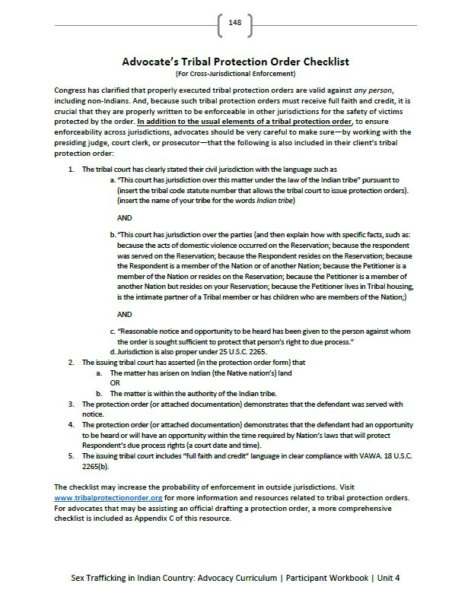
Advocate’s Tribal Protection Order Checklist
Notes:
Advocates checklist starts at page 148 in Participant Workbook

Slide 39
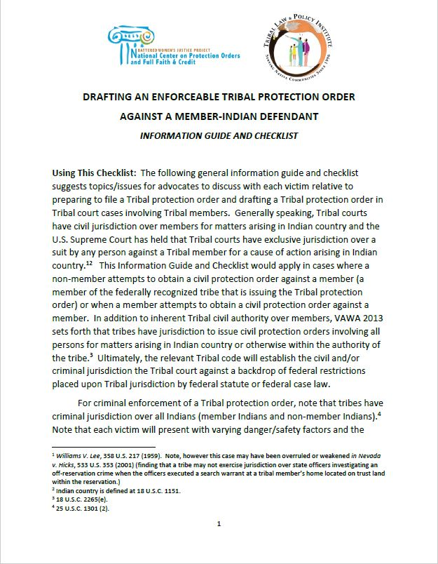
Drafting an Enforceable Tribal Protection Order Against a Member-Indian Defendant
Notes:
Kelly

Slide 40
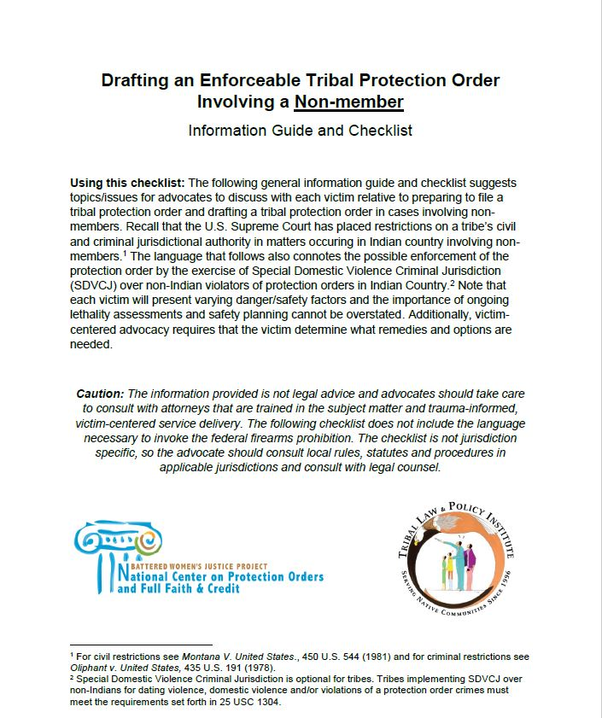
Drafting an Enforceable Tribal Protection Order Involving a Non-member
Notes:
Kelly

Slide 41
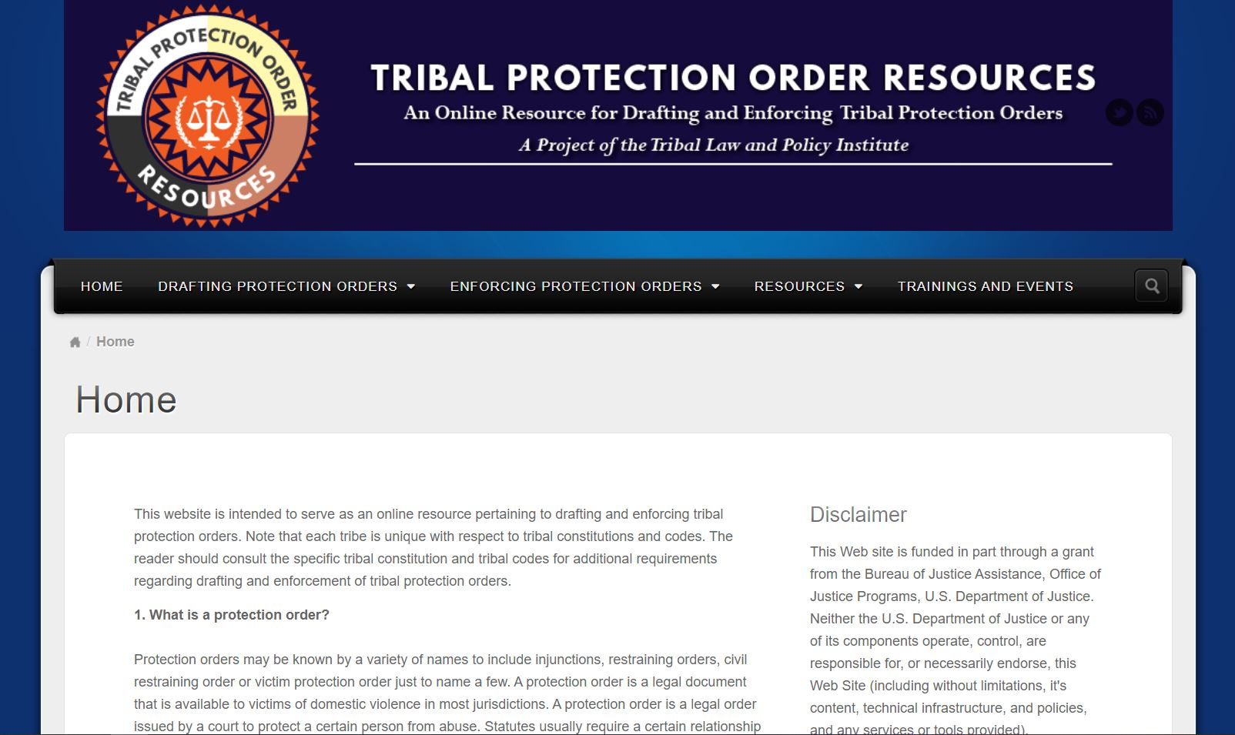
Tribal Protection Order Resources
www.TribalProtectionOrder.org
Notes:
Kelly

Slide 42
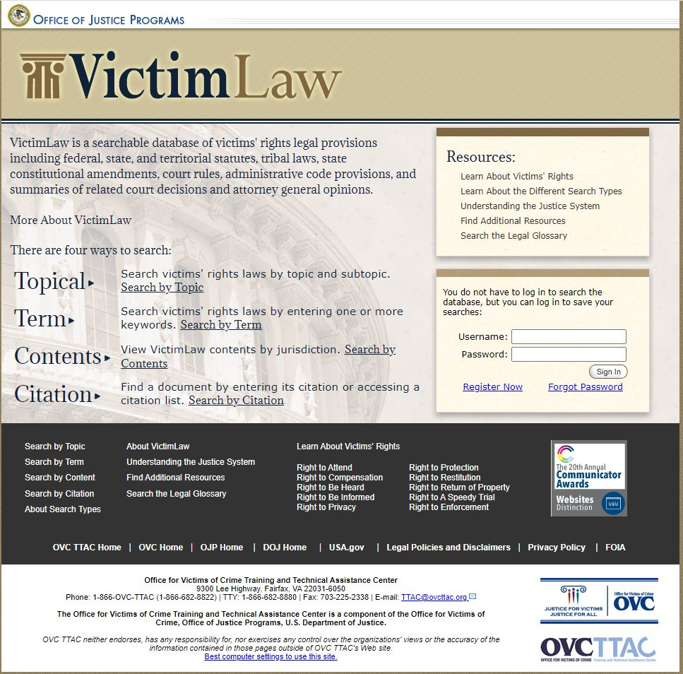
Tribal Protection Order Resources
www.VictimLaw.org
Notes:
Kelly

Slide 43
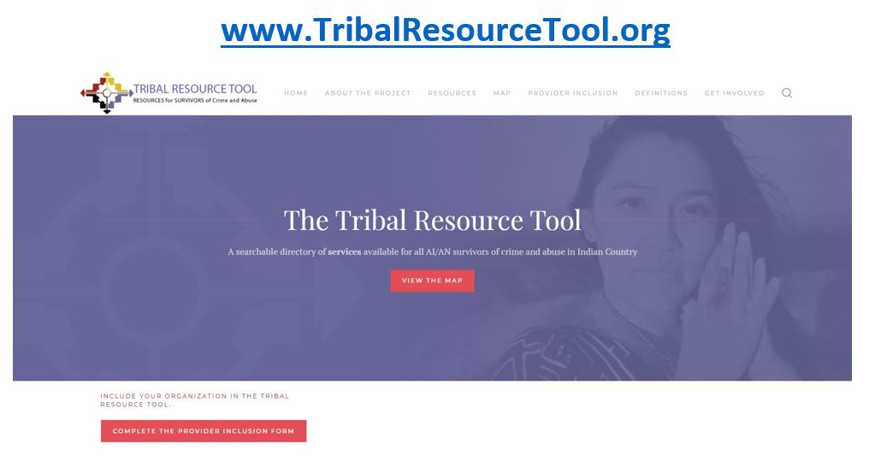
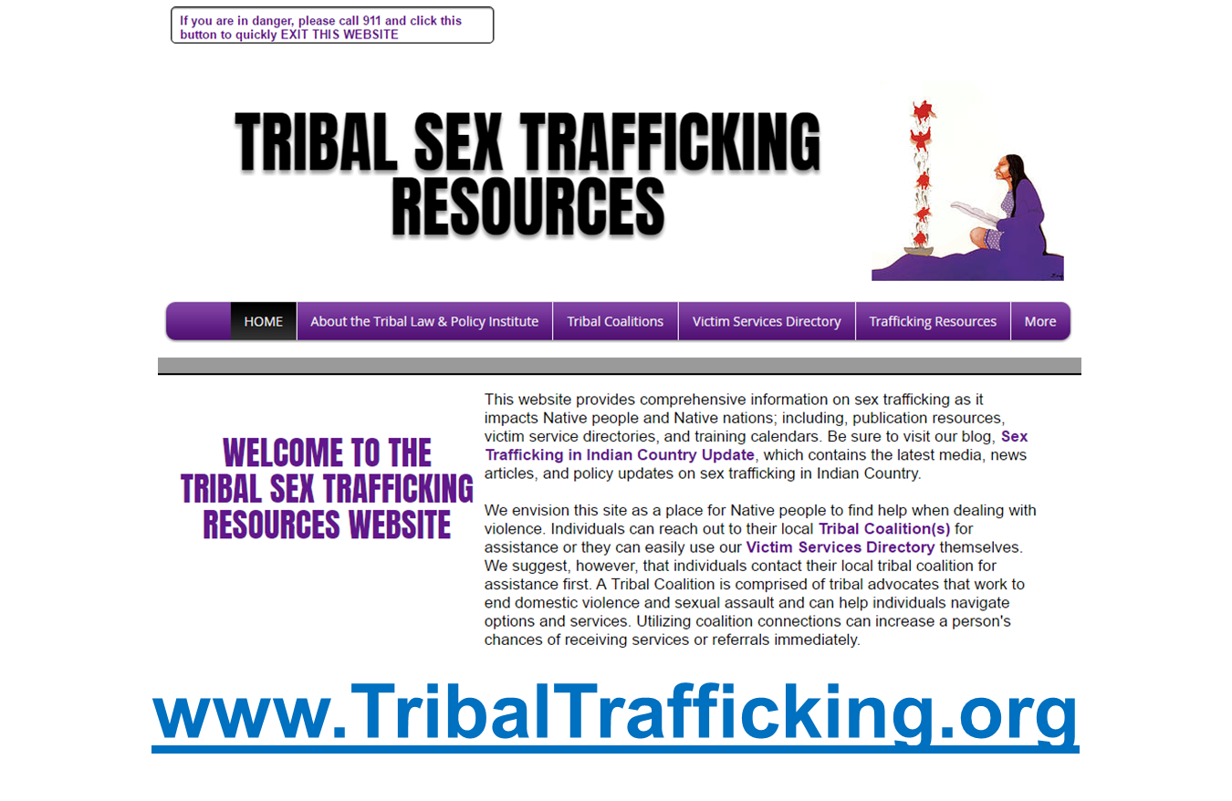
Additional Resources
Notes:
Bonnie
TribalResourceTool has Sex Trafficking resources by state/location

Slide 44
Webinar Wednesday Series
All of the previous webinars and PowerPoint slides from the Webinar Wednesday Series, Sex Trafficking in Indian Country: Advocacy Curriculum have be posted on www.TribalTrafficking.org. This webinar will be posted soon!
THANK YOU!
Notes:
Abby
Mention Certificate of Attendance

Slide 45

Questions?
Bonnie Clairmont, Victim Advocacy Specialist
  bonnie@tlpi.org
Kelly Gaines Stoner, Victim Advocacy Legal Specialist
  kelly@tlpi.org

