Slide 1


Sex Trafficking in Indian Country, Legal Advocacy, Part I
Webinar Wednesday Series
Wednesday, December 9, 2020
Prepared by the Tribal Law and Policy Institute
in collaboration with the Minnesota Indian Women’s Sexual Assault Coalition
This resource was supported by Grant No. 2013-TA-AX-K025, awarded by the Office on Violence Against Women, U.S. Department of Justice. The opinions, findings, conclusions, and recommendations expressed in this publication/program/exhibition are those of the author(s) and do not necessarily reflect the views of the Department of Justice, Office on Violence Against Women.
Notes:
Abby

Slide 2





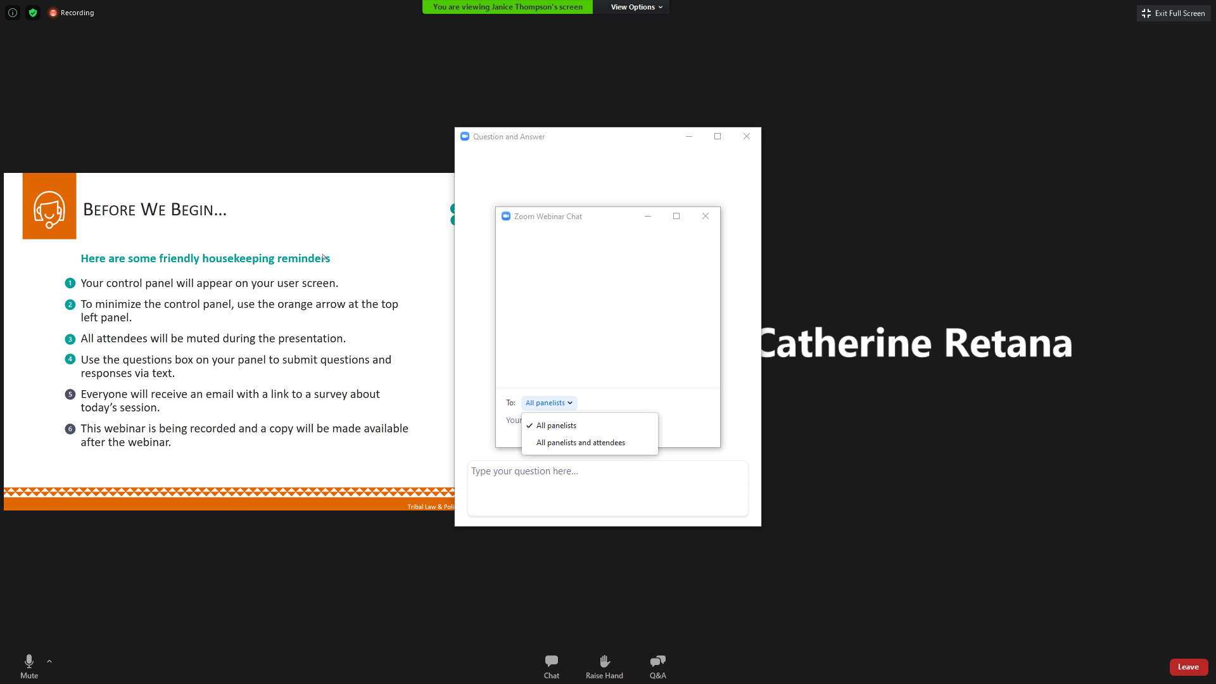
Friendly Housekeeping Reminders
Your control panel will appear at the bottom of your user screen. (As shown below)
All attendees will be muted during the presentation.
Use the Chat box to submit a comment to “All Presenters” or “Presenters & Everyone”
If you have a question, please type it in the Q&A box.
Please complete the evaluation survey, a link will be loaded in the chat box. The survey will also popup in your web browser when the session ends.
This session is being recorded. The video will be posted on www.TribalTrafficking.org
Notes:
Abby
Announce that previous videos are also posted.
Certificate of Attendance – all webinars in the series
We have made the videos available for anyone that has missed a previous webinar. Unfortunately, we cannot track those that watch the recordings and are only able to issue a Certificate of Attendance to those that have attended the full length of all the webinars live.
. How can you go back and re-watch this and previous webinars? Can the curriculum/PowerPoint be downloaded.

Slide 3


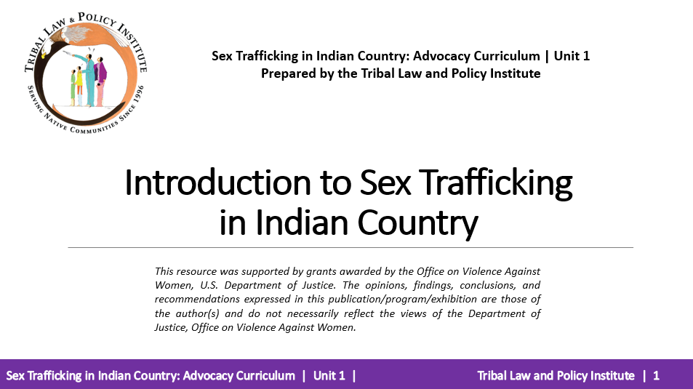
Download the Sex Trafficking in Indian Country: Advocacy Curriculum
https://www.home.tlpi.org/sex-trafficking
or visit
https://www.tribaltrafficking.org/sex-trafficking-advocacy-curriculum
Notes:
Abby

Slide 4
Training Agenda
Introductions, Agenda, Overview of Unit, and Learning Objectives
“Meeting Legal Advocacy Needs of Victims” – Small Group Exercise
Victim Advocacy Roles
Legal Advocacy Responsibilities
“Meeting the Legal Needs of Victims” – Small Group Exercise
Overview of Legal Needs in Criminal Systems
Overview of Legal Needs in Civil Systems
Navigating Criminal Jurisdiction In Indian country
Criminal Legal Advocacy
Victim’s Rights
Navigating Civil Jurisdiction in Indian country
Civil Legal Advocacy
Civil Protection Orders
Enforcing Tribal Protection Orders
Full Faith and Credit
Advocate’s PO Checklist
Question and Answer
Notes:
Heather

Slide 5
Learning Objectives
  As a result of participating in this workshop you will be better able to:
  Identify critical roles advocates fill when providing advocacy;
  Identify legal advocacy needs of sex trafficking victims;
  Identify concerns related to victim information;
  Identify potential needs of victims in criminal systems;
  Identify potential needs of victims in civil systems;
  Identify victim’s rights and explain the importance of each; and
  Identify important issues regarding tribal protection order issuance and enforcement.
Notes:
Heather

Slide 6
Small Group Exercise
Meeting the Legal Advocacy Needs of Sex Trafficking Victims
Notes:
Bonnie

Slide 7
Small Group Exercise
List 3 possible concerns victims may have about interacting with legal systems.
With each concern, brainstorm how an advocate might address those in a realistic but supportive way.
Notes:
Bonnie
KELLY AND BONNIE WILL REVIEW RESPONSES AND DISCUSS.

Slide 8
Victim Advocacy Roles
  Victim advocates role is to act as the BIASED supporter of Indian women experiencing violence and advocate for the victim’s EXPRESSED interests.
Notes:
Bonnie

Slide 9
Victim Advocacy Roles
  Direct Victim Advocacy
  Emotional and Family Support
  Community and Collaborator Accountability
  Legal System Advocacy
Notes:
Bonnie

Slide 10
Legal Advocacy Responsibilities
Legal advocacy may involve either or both the civil and criminal justice system, depending on the victim’s wishes. Both justice systems can be confusing for victims and as such, the advocate should be there to guide the victim through those systems. The advocate does this by providing accurate information about what the victim can expect and support the victim’s decisions throughout the process.
Notes:
Bonnie

Slide 11
Legal Advocacy Responsibilities
Protecting victim information;
Providing emotional support;
Help victims with safety planning;
Assisting a victim with obtaining a protection order (in both civil and criminal system);
Providing information on victim’s rights (in the criminal justice system);
Accompanying victim as needed and requested to hearings, trial, and appointments;
Working with other advocates involved in the case;
Monitoring case for compliance with policies, protocols, codes;
Providing follow up on cases as needed and appropriate; and
Educating service providers.
Notes:
Bonnie

Slide 12
Poll Question
Does your agency have written protocols in place that address protecting victim information?
Notes:
Response options: Yes or No

Slide 13
Legal Advocacy Responsibilities
  Protecting Victim Information
  Accompanying the Victim in the Courtroom
Notes:
Kelly

Slide 14
Protecting Victim Information
  Community based (grassroots);
  Hospital based;
  Prosecutor based; and
  Law enforcement based.
Notes:
Bonnie

Slide 15
Poll Question
What type of advocate are you?
  Community based (grassroots);
  Hospital based;
  Prosecutor based; and
  Law enforcement based.

Slide 16
Protecting Victim Information
Privacy
Confidentiality
Privilege
Notes:
Kelly

Slide 17
Protecting Victim Information - Privacy
Privacy is the expectation that when a victim shares information with another individual (the individual does not have to be a professional), the information will go no further without the victim’s consent.
Notes:
Kelly

Slide 18
Protecting Victim Information - Confidentiality
Protecting the confidentiality of communications is an ethical duty to keep the victim’s information private. Victim statements are meant only for the service provider and the information may only be disclosed with client consent. If the service provider discloses the victim’s information without the victim’s consent, the service provider may be liable for an ethical breach of duty and lose any of their licensure or certifications.
Notes:
Kelly

Slide 19
Protecting Victim Information - Confidentiality
Types of information that are usually confidential include:
Name/address of client requesting services;
Name/address of client receiving services;
Other private, identifying information about client (telephone number, birthdate, health issues, etc.);
Location of victim; and
Domestic violence shelter location.
Notes:
Kelly

Slide 20
Protecting Victim Information - Confidentiality
The victim’s permission to disclose certain victim information should be executed in a written release of information form that:
Lists what specific information you can disclose;
Identifies whom the information can be disclosed to;
Is signed by the client;
Includes an expiration date; and
Provides notice that the client can rescind their permission at any time if they choose.
Notes:
Kelly

Slide 21
Protecting Victim Information - Privilege
A privilege is an evidentiary rule that prevents the disclosure of information, even if relevant, in court. Particularly, privilege can come into play when the information was originally communicated in a professional or confidential relationship that is covered by law.
Notes:
Kelly

Slide 22
Protecting Victim Information - Privilege
Privileges that protect victim information from disclosure are usually set out in statutes or case law in the applicable jurisdiction.
A disclosure of the privileged information may have legal and/or criminal consequences. Note it is a best practice to have a tribal code that directly sets forth that communications between the victim and the advocate providing services are privileged and not subject to disclosure absent court orders or statutory mandate.
Notes:
Kelly

Slide 23
Victim Advocacy in the Courtroom
– Safety Planning
Victims may have a false sense of security going to court.
Victims may feel like they can let their guard down.
Violent outbursts can happen anywhere.
Notes:
Bonnie

Slide 24
Victim Advocacy in the Courtroom
– Safety Planning
Learn as much about the perpetrator as possible, particularly if the advocate has not seen them before.
Request law enforcement accompany the victim and advocate to the courthouse and courtroom.
Inquire about the presence of cameras in the parking lot. Park near cameras and closest entrances to the courtroom.
Notes:
Bonnie

Slide 25
Victim Advocacy in the Courtroom – Courtroom Decorum
Remember to demonstrate a deep respect for the sovereign (federal, state, or tribal);
Do your homework prior to appearing in court; and
Determine whether the trial or hearing will be a bench trial or jury trial.
Tip: Visit and observe the court in session with the judge presiding that will hear the victim’s case.
Notes:
Kelly

Slide 26
Victim Advocacy in the Courtroom
Be on time for court and urge the victim to be on time;
  Tell them to show up at least 30 minutes before the scheduled time;
Make sure there is a safe and private place to wait for the case to be called;
Dress respectfully; and
Stand when speaking to the Judge.
Notes:
Kelly

Slide 27
Victim Advocacy in the Courtroom
DO NOT bring confidential information with you to court unless court ordered (not a subpoena duces tecum) to do so.
  This is critical as any documentation that is brought to court is subject to discovery!
DO NOT discuss the case while on the courthouse grounds.
  It is amazing how many ears are in very private places on the courthouse grounds!
Notes:
Kelly

Slide 28
Victim Advocacy in the Courtroom
BEWARE OF THE UNAUTHORIZED PRACTICE OF LAW!
Be clear that you are the victim advocate, and not the victim’s lawyer.
Notes:
Kelly

Slide 29
Poll Question
Do you accompany victims to criminal court?
Notes:
Kelly
Response options: yes or no

Slide 30
Poll Question
Do you accompany victims to civil court?
Notes:
Kelly
Response options: yes or no

Slide 31
Small Group Exercise
What are the legal needs of a sex trafficking victim?
Identify civil and/or criminal legal needs with your small group.
Notes:
KELLY
Put responses in the chat box.

Slide 32
Overview of Legal Needs in Criminal Systems
In criminal legal systems, sex trafficking victims will need assistance with preparation for trial, seeking a criminal no contact order, asserting victim’s rights, and preparing and delivering victim impact statements.
Notes:
Kelly

Slide 33
Overview of Legal Needs in Criminal Systems
The victim’s own criminal case
  Affirmative defenses, immunity from prosecution, expungements, and victim’s rights.
The trafficker’s criminal case
  Filing a police report, witness statements, trial accompaniment, protection orders, and general advocacy.
Notes:
Kelly

Slide 34
Overview of Legal Needs in Civil Systems
In civil legal systems, a civil legal remedy is simply using the law or authority of the court to enforce a legal right or other legal relief to the victim. Victim compensation and protection orders are types of legal relief.
Notes:
Kelly

Slide 35
Overview of Legal Needs in Civil Systems
Employment law;
Tort law;
Housing laws;
Debtor/creditor law;
Family law;
Domestic violence law;
Children’s civil legal needs; and
Protection orders.
Notes:
Kelly

Slide 36

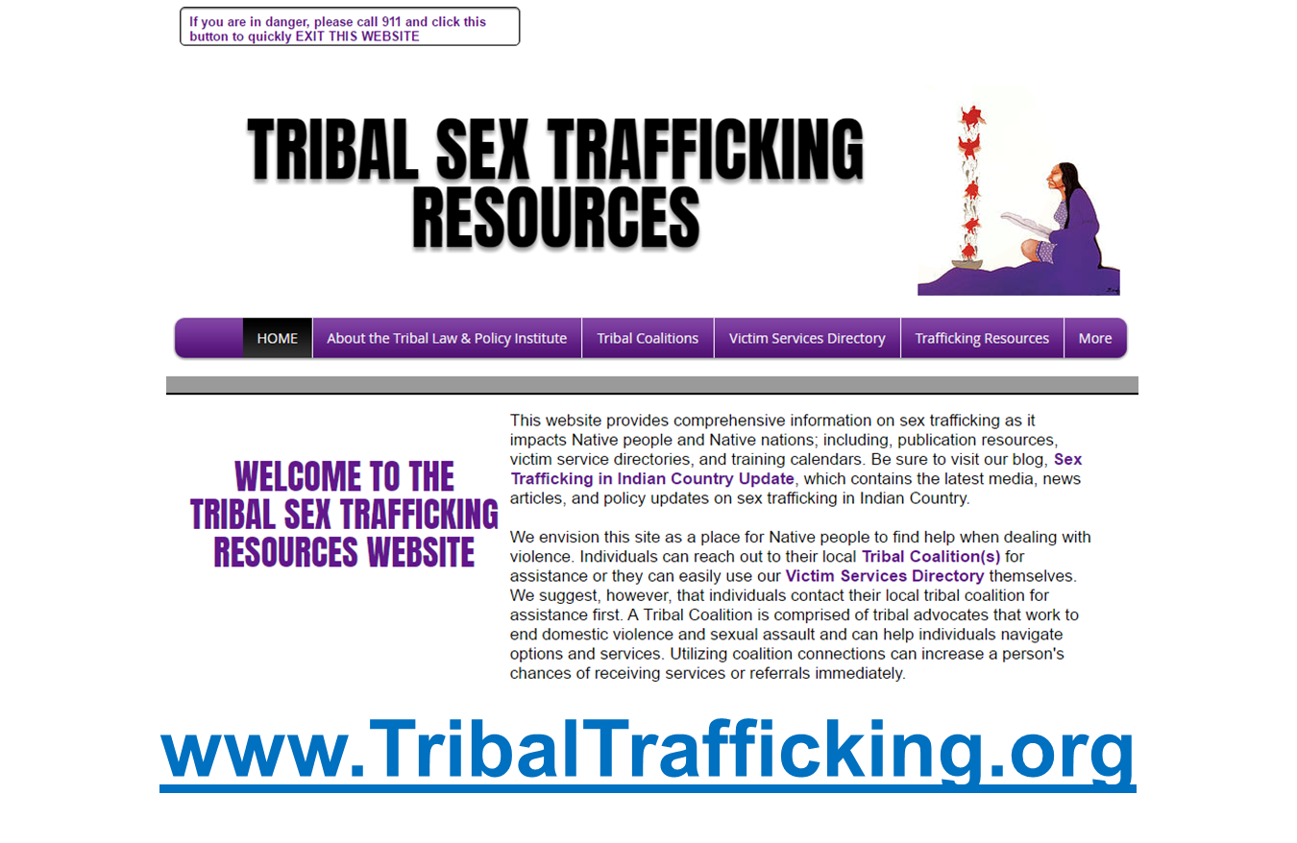
Additional Resources
Notes:
Bonnie
TribalResourceTool has Sex Trafficking resources by state/location

Slide 37
Webinar Wednesday Series
Wednesday, October 14: Introduction to Advocacy Curriculum (90 min)
Wednesday, October 28: Unit 1 - Introduction to Sex Trafficking in Indian Country (90 min)
Wednesday, November 11: Unit 2 - Identifying and Screening for Sex Trafficking (105 min)
Wednesday, November 25: Unit 3 - Advocacy for Victims of Sex Trafficking (90 min)
Wednesday, December 9: Unit 4 - Legal Advocacy, Part I (90 min)
Wednesday, December 23: Unit 4 - Legal Advocacy, Part II (90 min)
All webinars will begin at 11:00am PT/12:00pm MT/1:00pm CT/2:00pm ET.
Register for the Webinar Wednesday Series on Zoom: https://rb.gy/rhdef2
Notes:
Abby
Drop registration link in chat box.
These are the remaining webinars in our series.
Due to the virtual forum and volume of interest, we may not be able to get through all the exercises. We recommend running through all exercises with your teams, communities, families post-webinar.
Survey Link: https://www.surveymonkey.com/r/Z3ZXBPG

Slide 38

Questions?
Bonnie Clairmont, Victim Advocacy Specialist
  bonnie@tlpi.org
Kelly Gaines Stoner, Victim Advocacy Legal Specialist
  kelly@tlpi.org

